Slide 1


Your Best Trims Partner Ever!
您最好的辅料合作商

Slide 2


This is about
关于
The Company 公司
Our Strength 实力
Our Service 服务
Our Facility设备

Slide 3
Aims to strengthen the cooperation,
for a Win-win situation.
合作共赢
All customers

Slide 4
So, what’s
?
Your BEST global trims supplier!
做好的全球辅料供应商

Slide 5
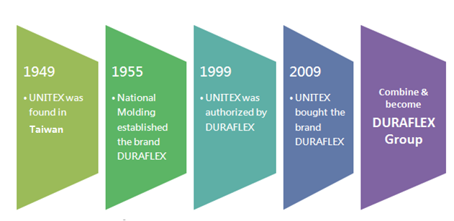

Unitex History
历史
Duraflex is a well known global trims supplier
of outdoor backpack and equipment since 60 years ago.
多耐福是一个全球知名品牌，从事户外背包和配件超过60年历史

Slide 6
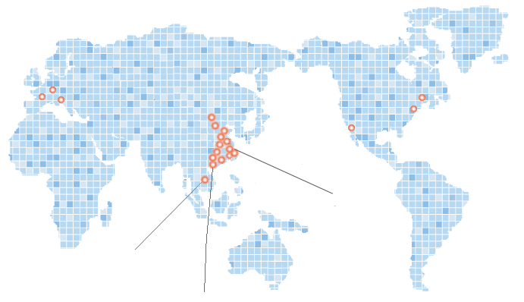
Our Global Network 全球网络
Brand sales team: 4 America teams, 2 Europe teams, 12 Asia teams
品牌销售团队：美国4个，欧洲2个，亚洲12个
The factory sales team: 12 sales offices, + 300 members
业务团队：7个业务办，+300业务同事
Production plant: 5 factories, +200 machines, +2000 staffs
产地分布：5间工厂，+200机台，+2000员工
US factory
(NMC)
Italy factory
(NMI)
China-Shanghai factory
(2005)
Vietnam factory
(2009)
China-Shenzhen factory
(1991)

Slide 7

Our Asian Sales Network-亚洲销售网络
Tianjing, Qingdiao
天津，青岛
Nanjing, Suzhou
南京，苏州
Xiamen, Guangzhou, Zhongshan
厦门，广州，中山
Hong Kong(Head office) 香港
Vietnam, Shenzhen, Jiashan
越南，深圳，嘉善
Taiwan 台湾

Slide 8

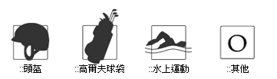
Industries Served 客户行业分布
Back pack
背包
Garment
成衣
Military
军用
Baby strollers
童车
Helmet
头盔
Golf Bag
高尔夫
Water Sports
水上运动
Others
其它

Slide 9























Our Key Customers
重点客户
Over 130 Active Customers
Market Share over 30%

Slide 10
Why
?
We are MORE than a supplier.
我们不只是一个辅料供应商

Slide 11


Manufacturing
生产
Design
设计
Sales
销售
We design ,We produce, We sell.
设计，生产，销售一条龙服务

Slide 12

Concept
Product
Our professional R&D teams converts your ideas to actual products
专业的设计团队将您的想法实现

Slide 13


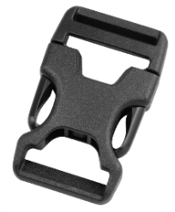
Concept
Product
Our professional Product teams create some new ideas to real products
专业的团队自主研发创新新产品

Slide 14






















Over 800 sets custom-made product a year
年开发客户专用产品超过800套
With strong customer network

Slide 15
What does
sell?
Not only product , but Innovation & Good Quality.
多耐福销售，除了产品更是创意和品质

Slide 16
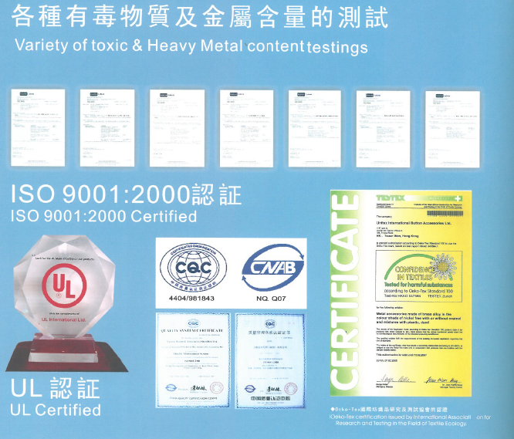
Our International Quality Standard
国际品质标准
We are honor to be the 1st Bluesign
authorized trims supplier since 2010.

Slide 17
What is
about?
Environmental, health, safety EHS suggestions provide
环保，健康，员工安全
Analysis from row material, chemical content, water & power resource aspects
关注原材料，化学成分，水以及能源
Well-managed manufacturing process
有效管理工厂的各环节

Slide 18
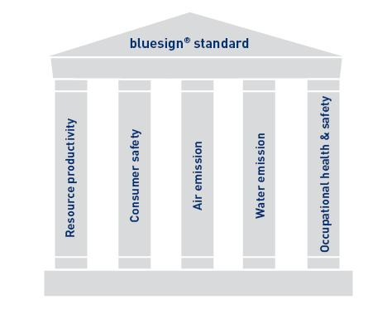
Around the 5 major issues
生产，消费者安全，气排放，水排放，职业安全

Slide 19







Bluesign ® Members
蓝色认证成员
Still increasing

Slide 20
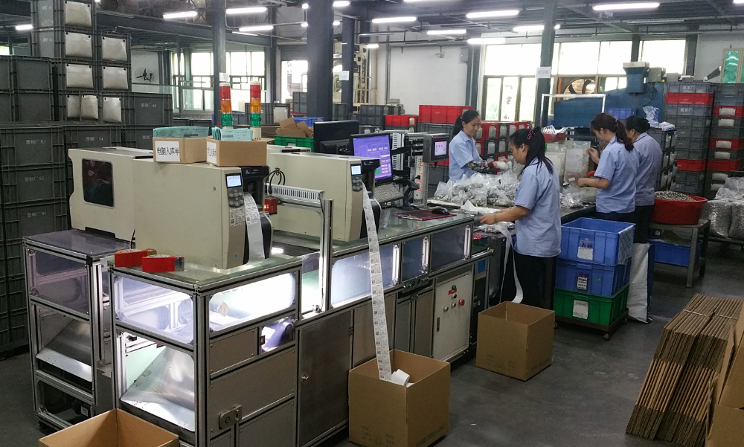
Our factory工厂
Warehouse 仓库

Slide 21
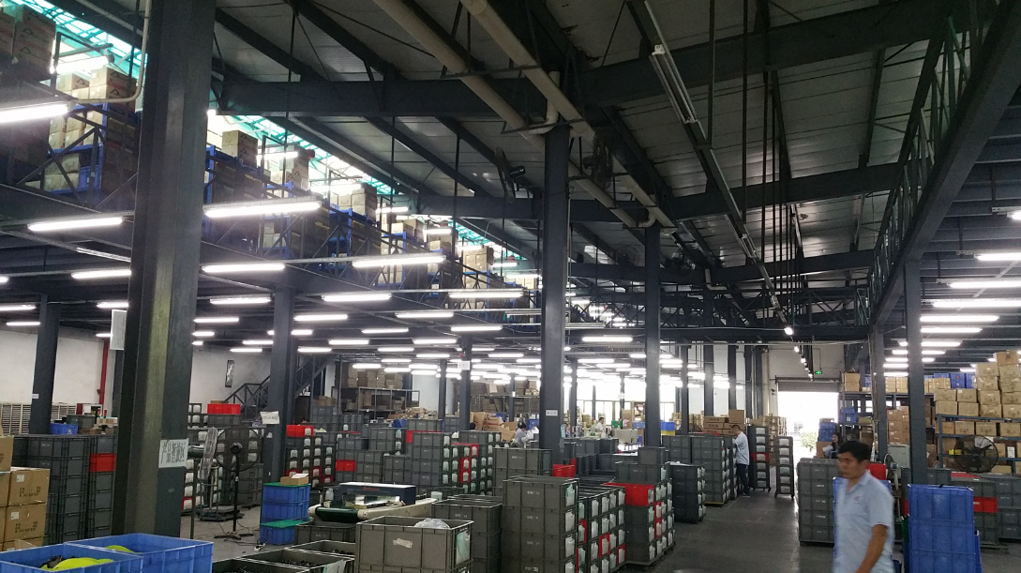
Warehouse Full view 仓库全景

Slide 22
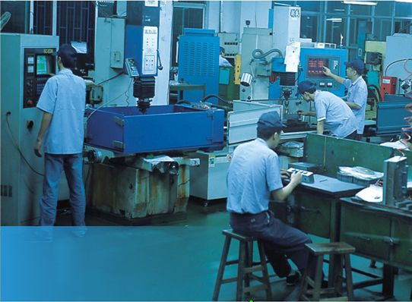
Tooling Department工模厂

Slide 23
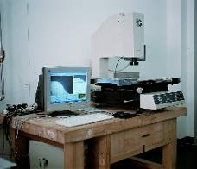
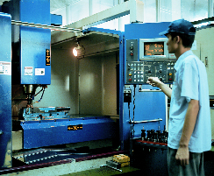
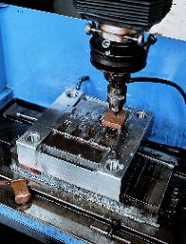
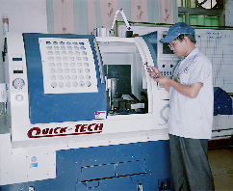
Tooling Department工模厂
Monthly capacity: 月产能
30+ plastic production mold +30套塑胶模
10+ metal stamping mold+10套金属冲模
10+ logo mold+10套花馍

Slide 24
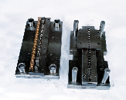
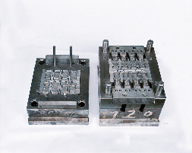
Mold 模具
Metal stamping mold Plastic part mold
金属冲模 塑胶注塑模

Slide 25
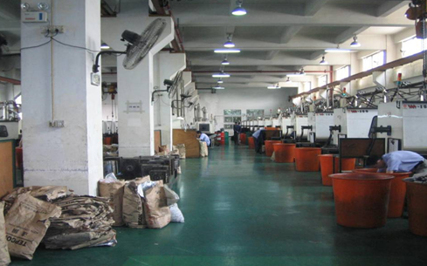
Injection Department 注塑部
Material:POM,Nylon TPU,TPR and so on材料：POM，Nylon，TPR，TPU等
Machine: Horizontal Machine& Vertical Machine(130 Machines)
机台：卧式机&立式机（130台机台）

Slide 26
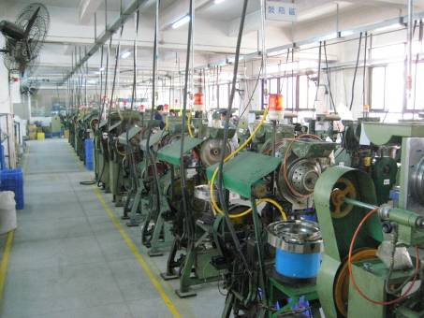
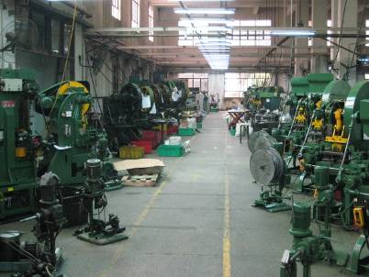


Metal Department 金属部
Material: Brass, Steel, Aluminum
75 Hi-speed stamping press 75台冲床
14 Spring setting machine 14台装簧机
15 Button/Stud setting machine
15台公扣缩腰机
86 Assembly machine 86台组装机
34 socket inspection machine
34台母扣检验机
14 Aluminum tack machine 14台铝钉机

Slide 27
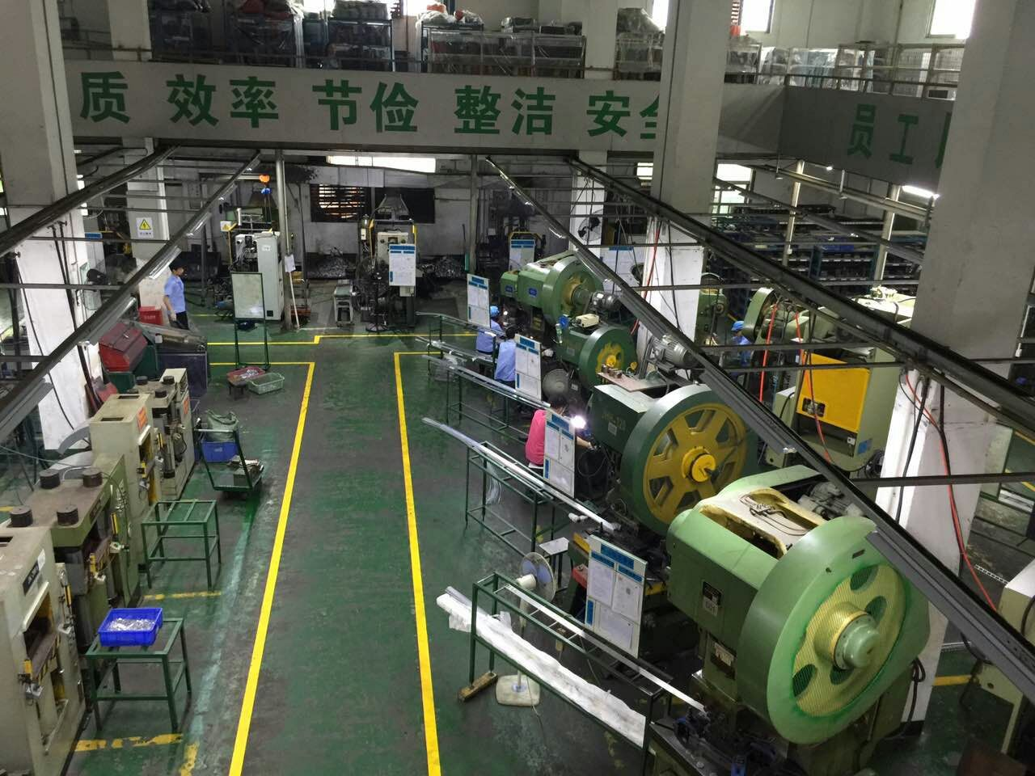
Zinc&Aluminum Department
Full view锌合金铝合金部门全景

Slide 28
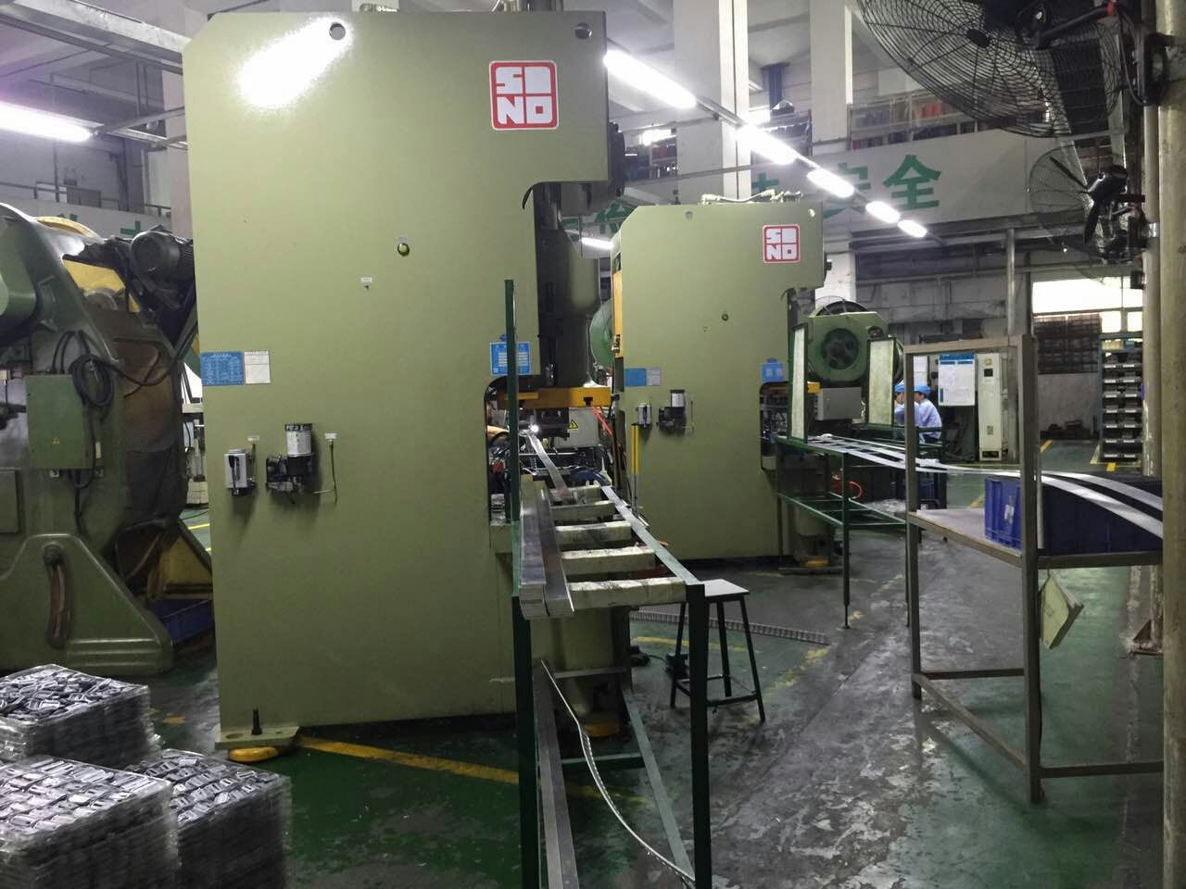
Aluminum Stamping machine
铝合金冲压机

Slide 29
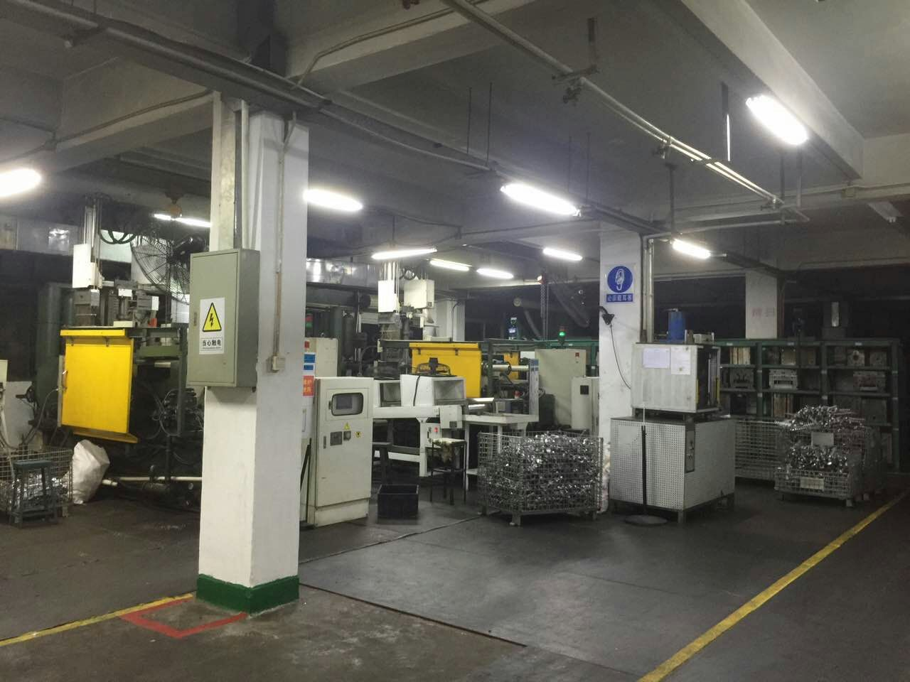
Die casting machine
锌合金压铸机

Slide 30
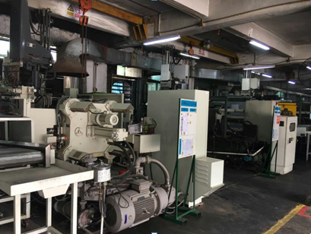
Aluminum Die casting machine
铝合金压铸机
Machine: Made in Japan日本原装进口机台

Slide 31
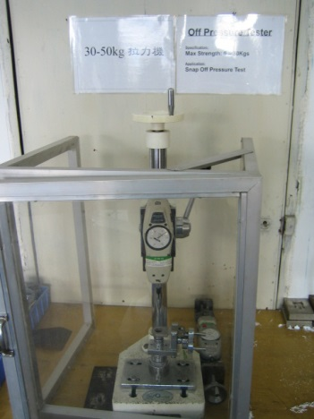
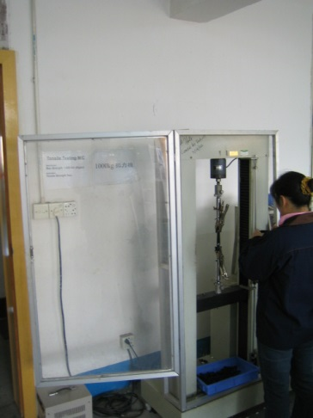
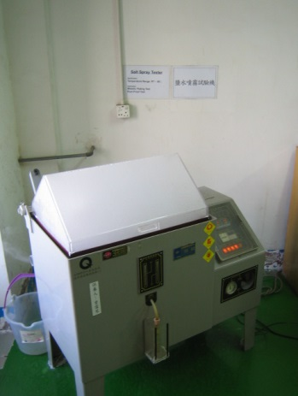
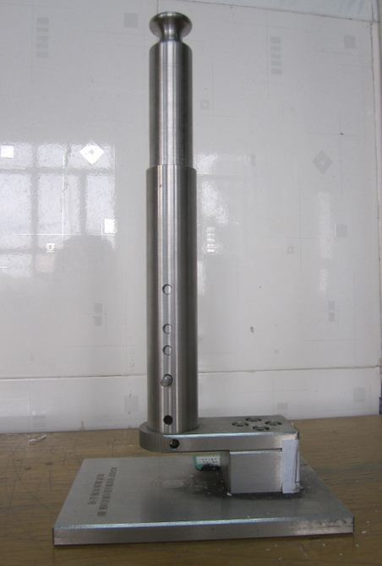
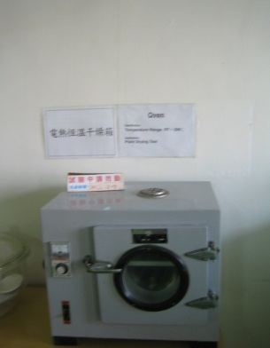
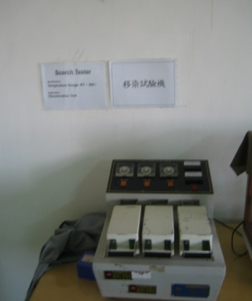
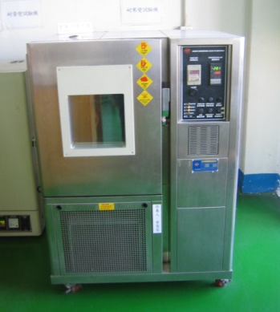
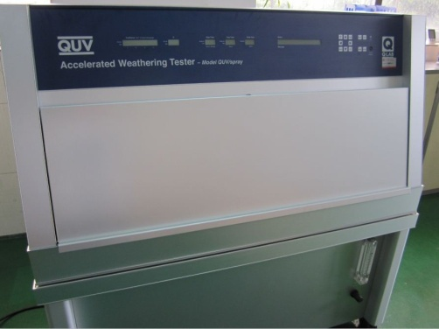
Quality Department---Internal Quality Assurance
品检部
Tensile Strength
Machine 拉力机
Tensile Strength
Machine 拉力机
Salt Spray Tester盐雾测试机
Impact Testing Machine 撞击测试机
Heated dryer
烘干机
Scorch Tester
移染测试机
Frozen/Heat
Testing Chamber
冷/热测试机
Weathering Tester
UV测试仪

Slide 32
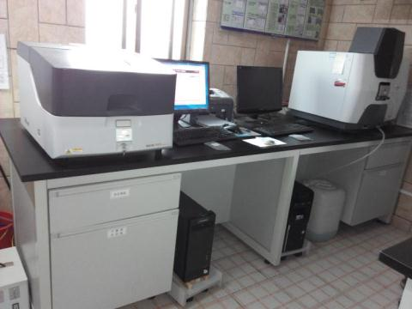
Production Batch Detection of Lead Tolerance
铅含量测试

Slide 33
How about
manufacturing power?
Automation is our goal.
工厂产能，自动化是我们的目标

Slide 34
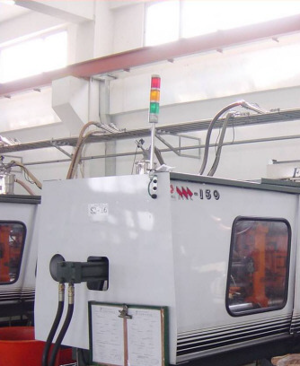
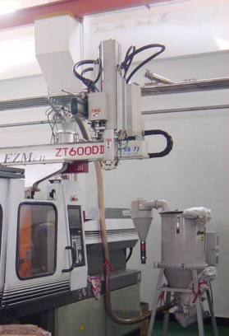
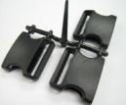


Traditional Injection Machine with mechanical arm
传统注塑机加装机械手臂

Slide 35
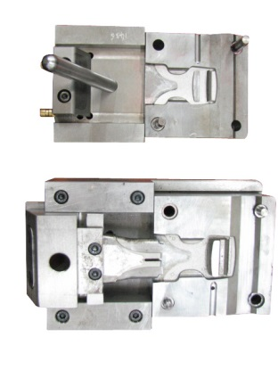
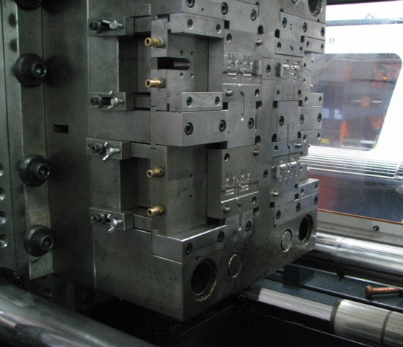
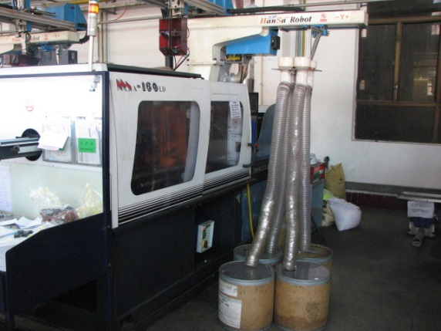
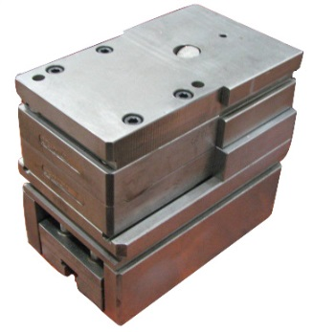
Modular Mold System
快速换模系统

Slide 36
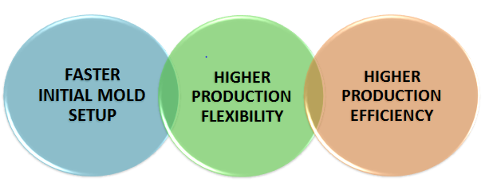
Modular Mold System
快速换模系统
快速 灵活 高效

Slide 37
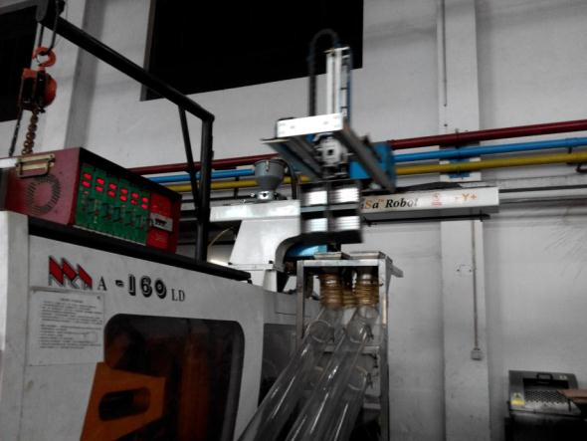
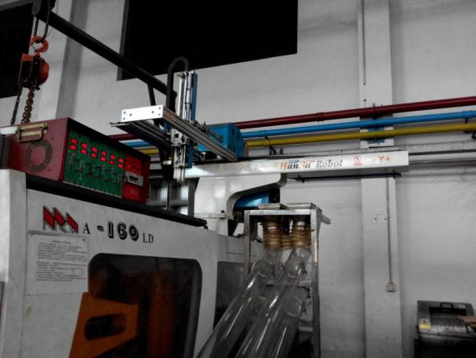
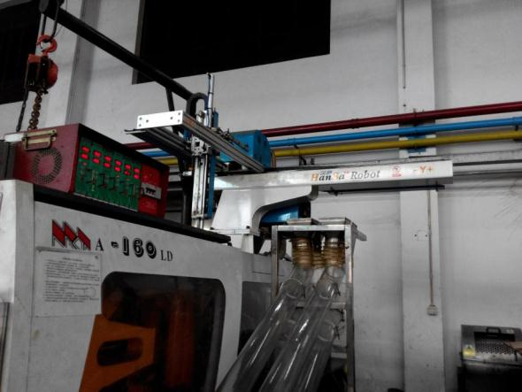
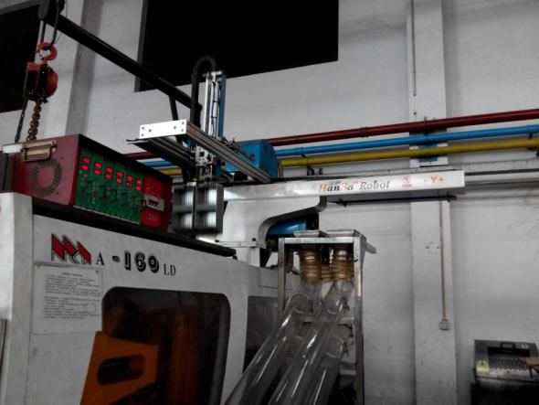
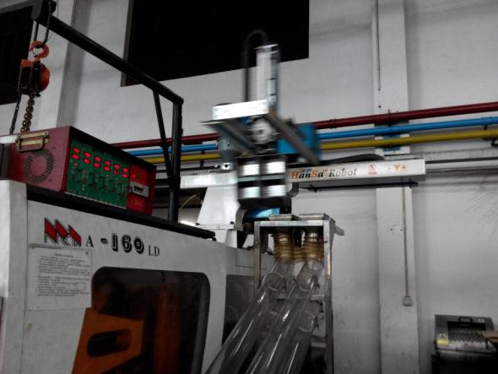
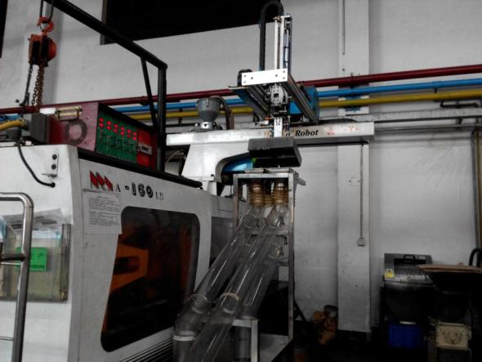
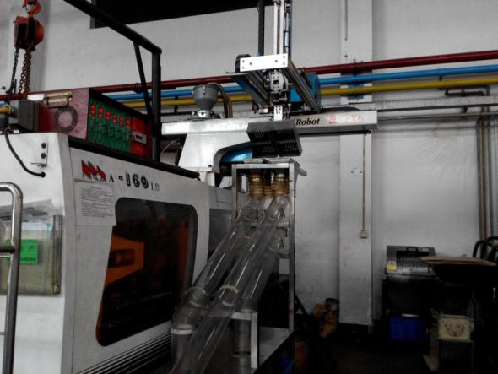
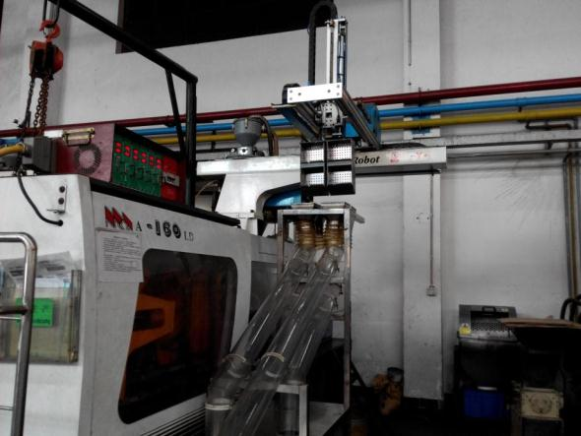
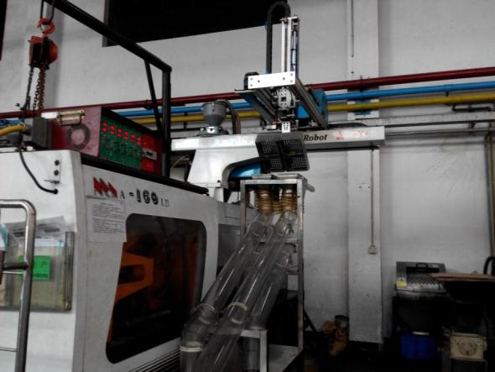
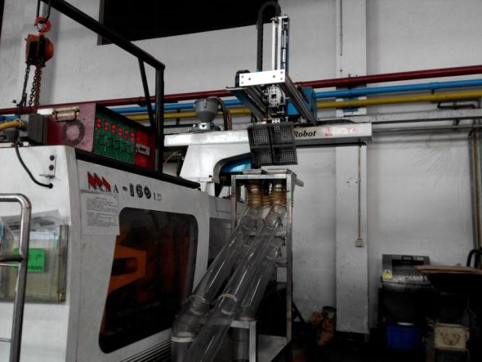
Automatic Production – Horizontal Machine
全自动生产

Slide 38
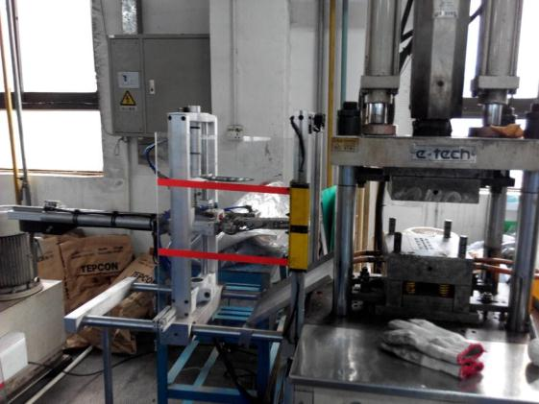

Automatic Production – Vertical Machine
立式机自动手臂

Slide 39








Automatic Production – Puller Cord Welding
绳子自动熔切机

Slide 40




Automatic Production – Assembly 自动组合机

Slide 41




Automatic Production – Assembly 自动组合机

Slide 42
Your Best Trims Partner Ever!
Thanks You !

