Slide 1
Company Profile

Slide 2
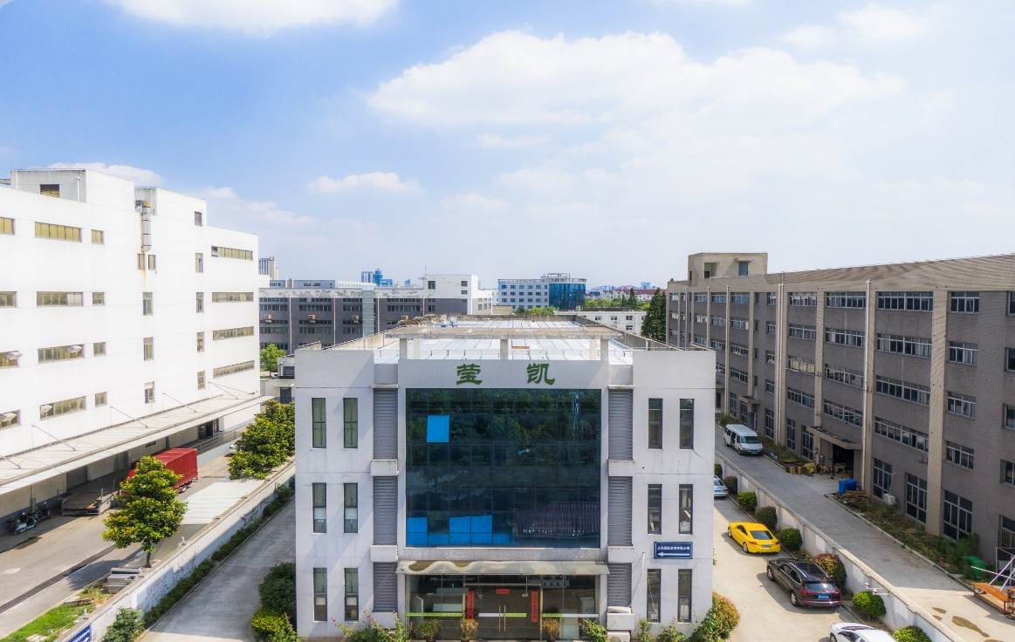
Win-Win
共赢
Partner
合作
Innovation创新

Slide 3
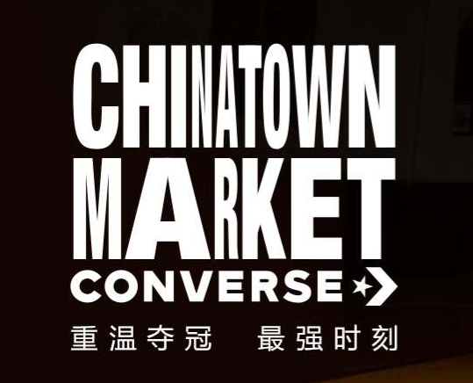
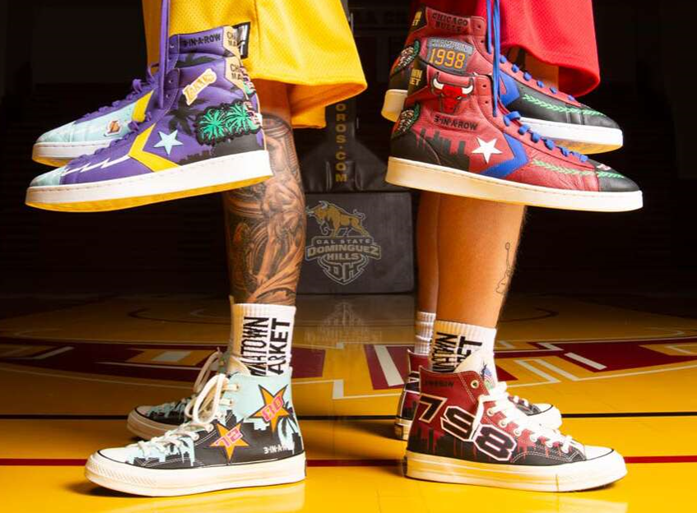
CONTENT
1. Company Introduction
公司介绍
2. Main Products
主要产品
3. Quality Control
品质管控
4. Core Competitive Advantages
核心竞争优势

Slide 4
CONTENT
1. Company Introduction
公司介绍
2. Main Products
主要产品
3. Quality Control
品质管控
4. Core Competitive Advantages
核心竞争优势

Slide 5
Corporate culture 企业文化
Integrity
诚信
Innovation
创新
诚信铸就品质，
造就长青基业
积极创新、卓越品质、
附能客户
Profession
专业
Mission
使命
成为产品专家，
引领行业趋势
成就客户、成就品牌、
成就员工

Slide 6
Trims Solution Provider
辅料解决方案供应商
Heat Transfer Label
热转印标
Silicon Badges
硅胶章
Yingkai
focuses on trims development and manufacture, located in Shanghai, Dongguan, and Wuhu City.
专注于辅料开发和生产，工厂分布于上海市、东莞市、芜湖市。
Voltage
stamp
电压标
Elevator
吊牌
Trims
辅料
Woven Label
织唛
Embroidery Badges
绣花章

Slide 7
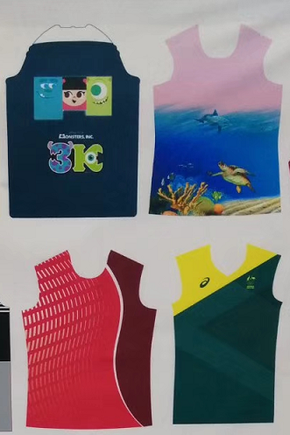
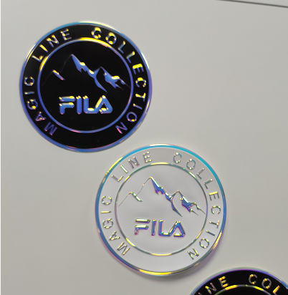
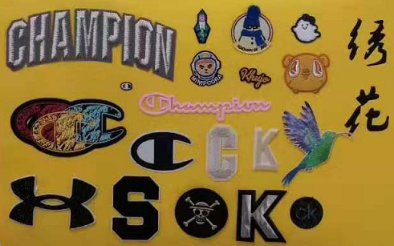
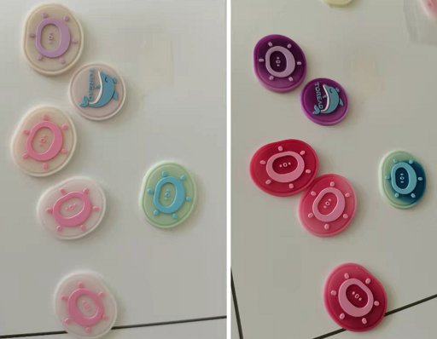
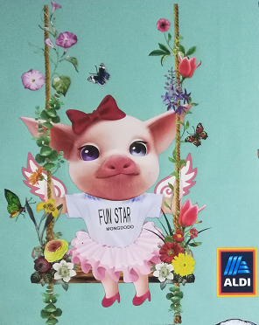
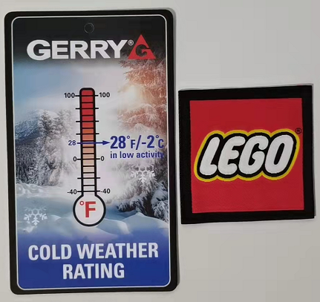
电压标牌
数码升华
模具硅胶
（光变）
吊牌
柯式烫画
织唛

Slide 8
Globalization 全球化
We have manufacturing facilities in Wuhu Anhui, Dongguan Guangdong, Shanghai; Jiaxing;and Vietnam.
分别在安徽芜湖、上海、嘉兴、广东东莞，越南都有生产工厂。
AMERICA
QINGDAO
ANHUI
SHANGHAI
FUJIAN
GUANGDONG
VIETNAM

Slide 9
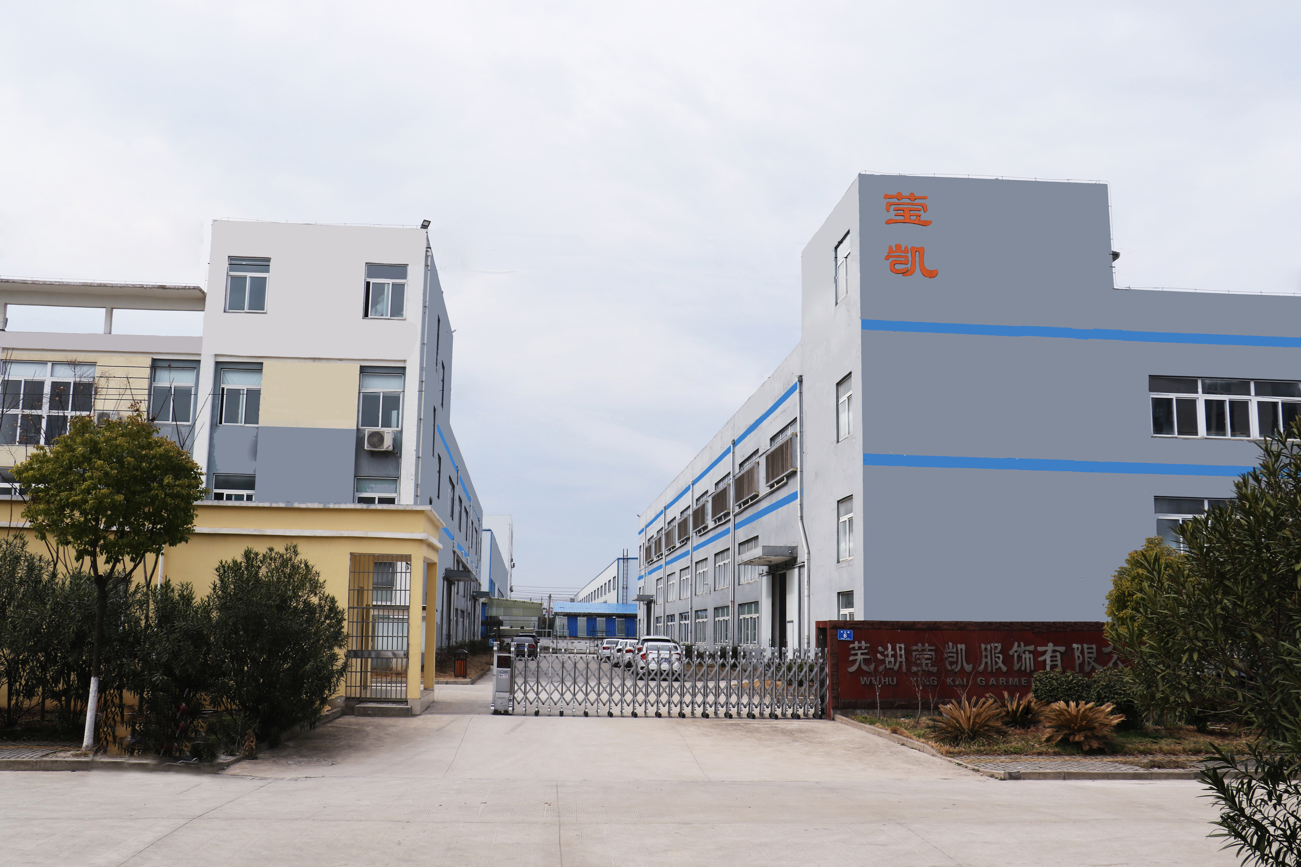
Wuhu factory 芜湖工厂

Slide 10
Wuhu factory 芜湖工厂
Has Silicon badges capacity 2 million pcs per month.
拥有硅胶章产能每个月200万
Has 18 Heat Transfer Label Fully-automatic production lines.
拥有18条全自动化热转印标生产线
Has 16 Semi-automatic screen printing lines and 5 Manual screen printing lines.
拥有16条半自动化热转印标生产线
Total capacity for the Heat Transfer Labels is 1.2 millions sheets per month, 100pcs/sheet.
热转印标产能达到每月120万张，100个标每张

Slide 11
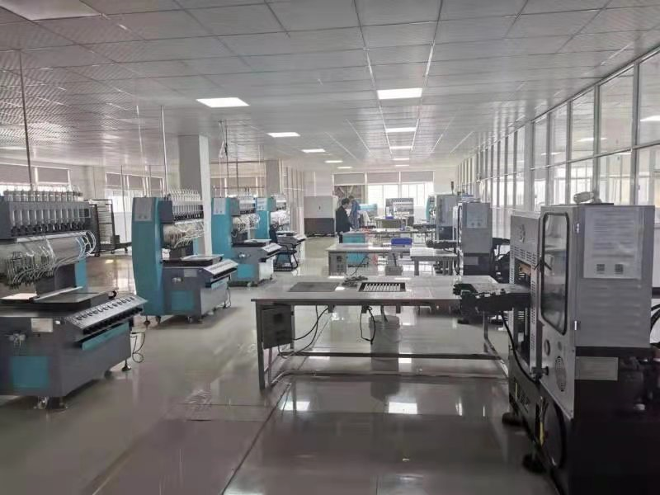
Wuhu factory –Silicon Badges
芜湖工厂-硅胶章车间

Slide 12
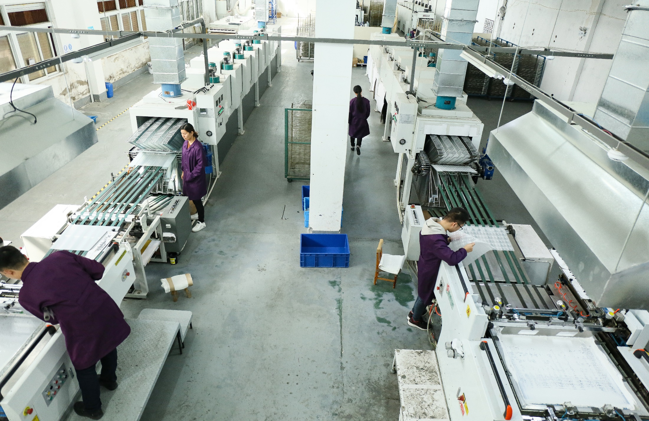
Wuhu factory-Fully-Automatic Production Line
芜湖工厂-全自动生产线

Slide 13
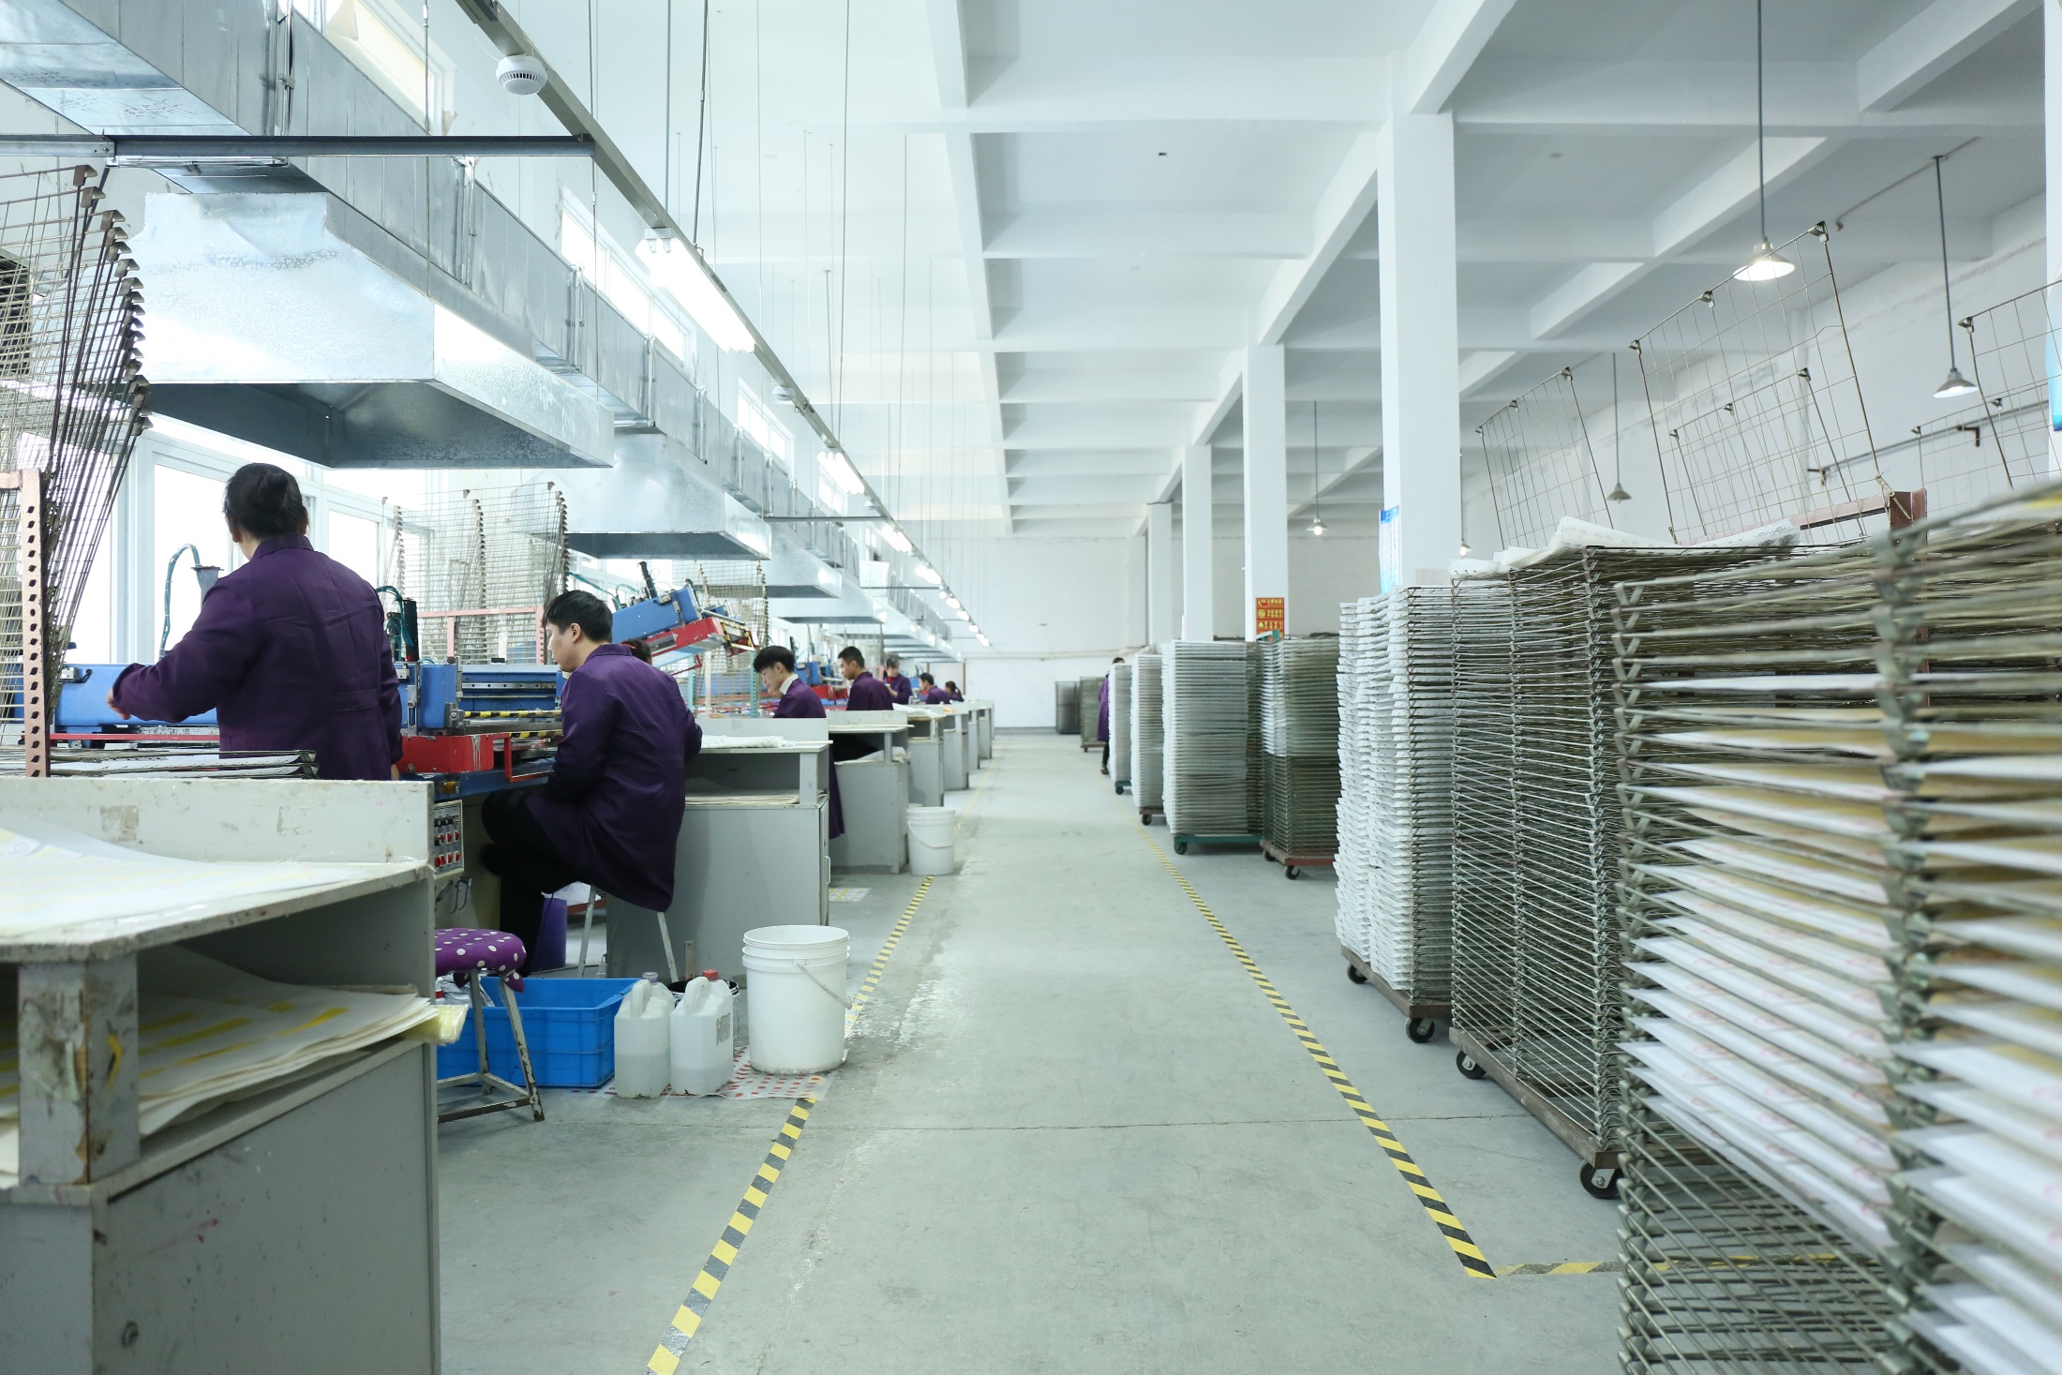
Wuhu factory-Semi-Automatic Production Line
芜湖工厂-半自动生产线

Slide 14
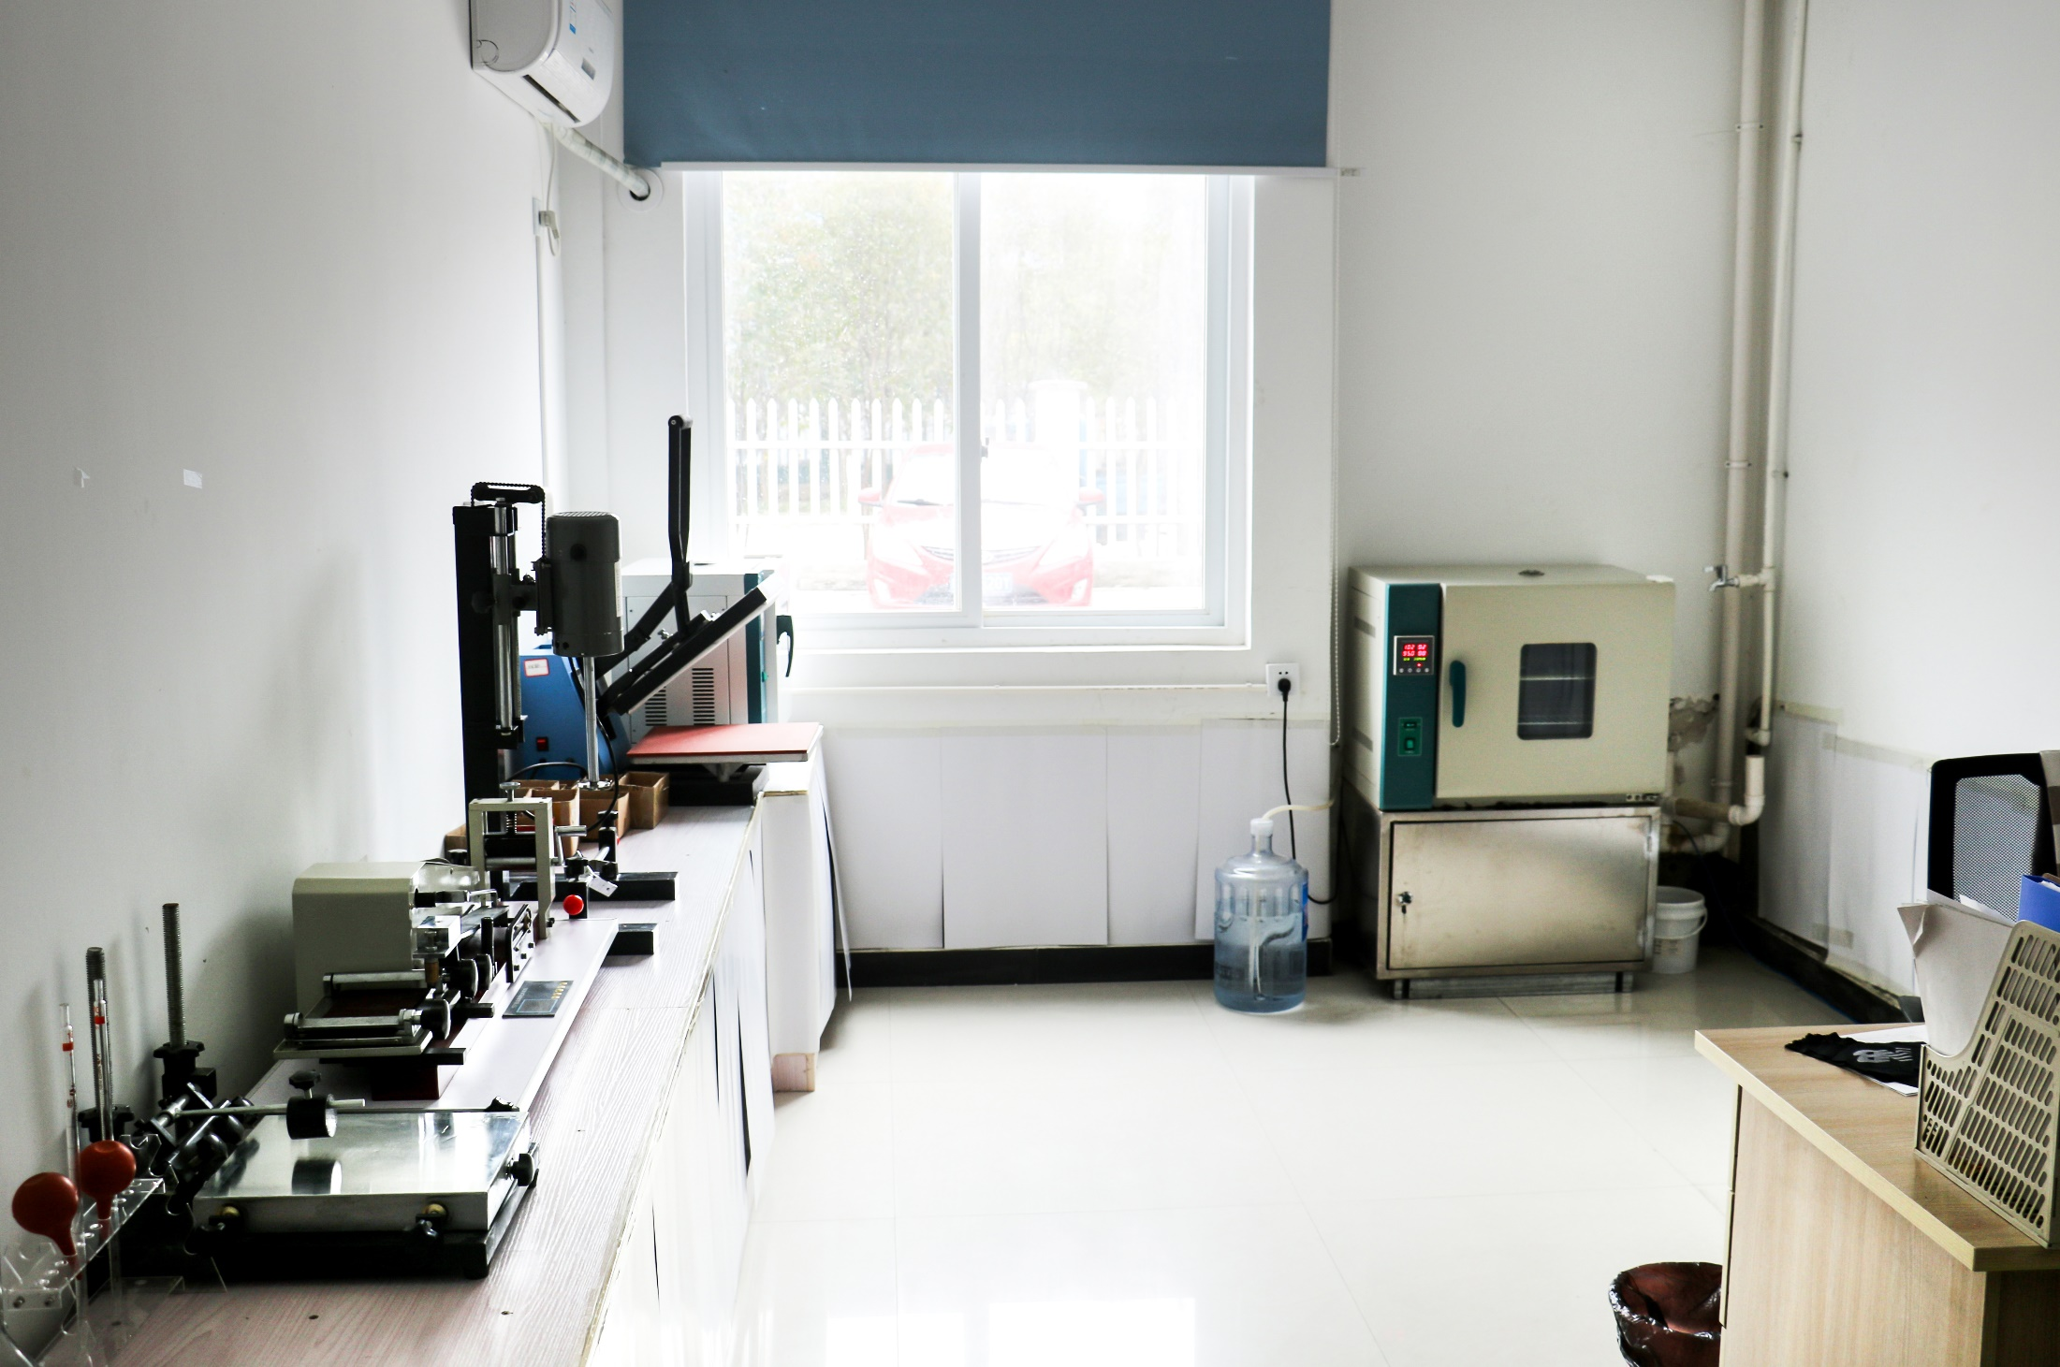
Wuhu factory-In-house Lab
芜湖工厂-工厂实验室

Slide 15
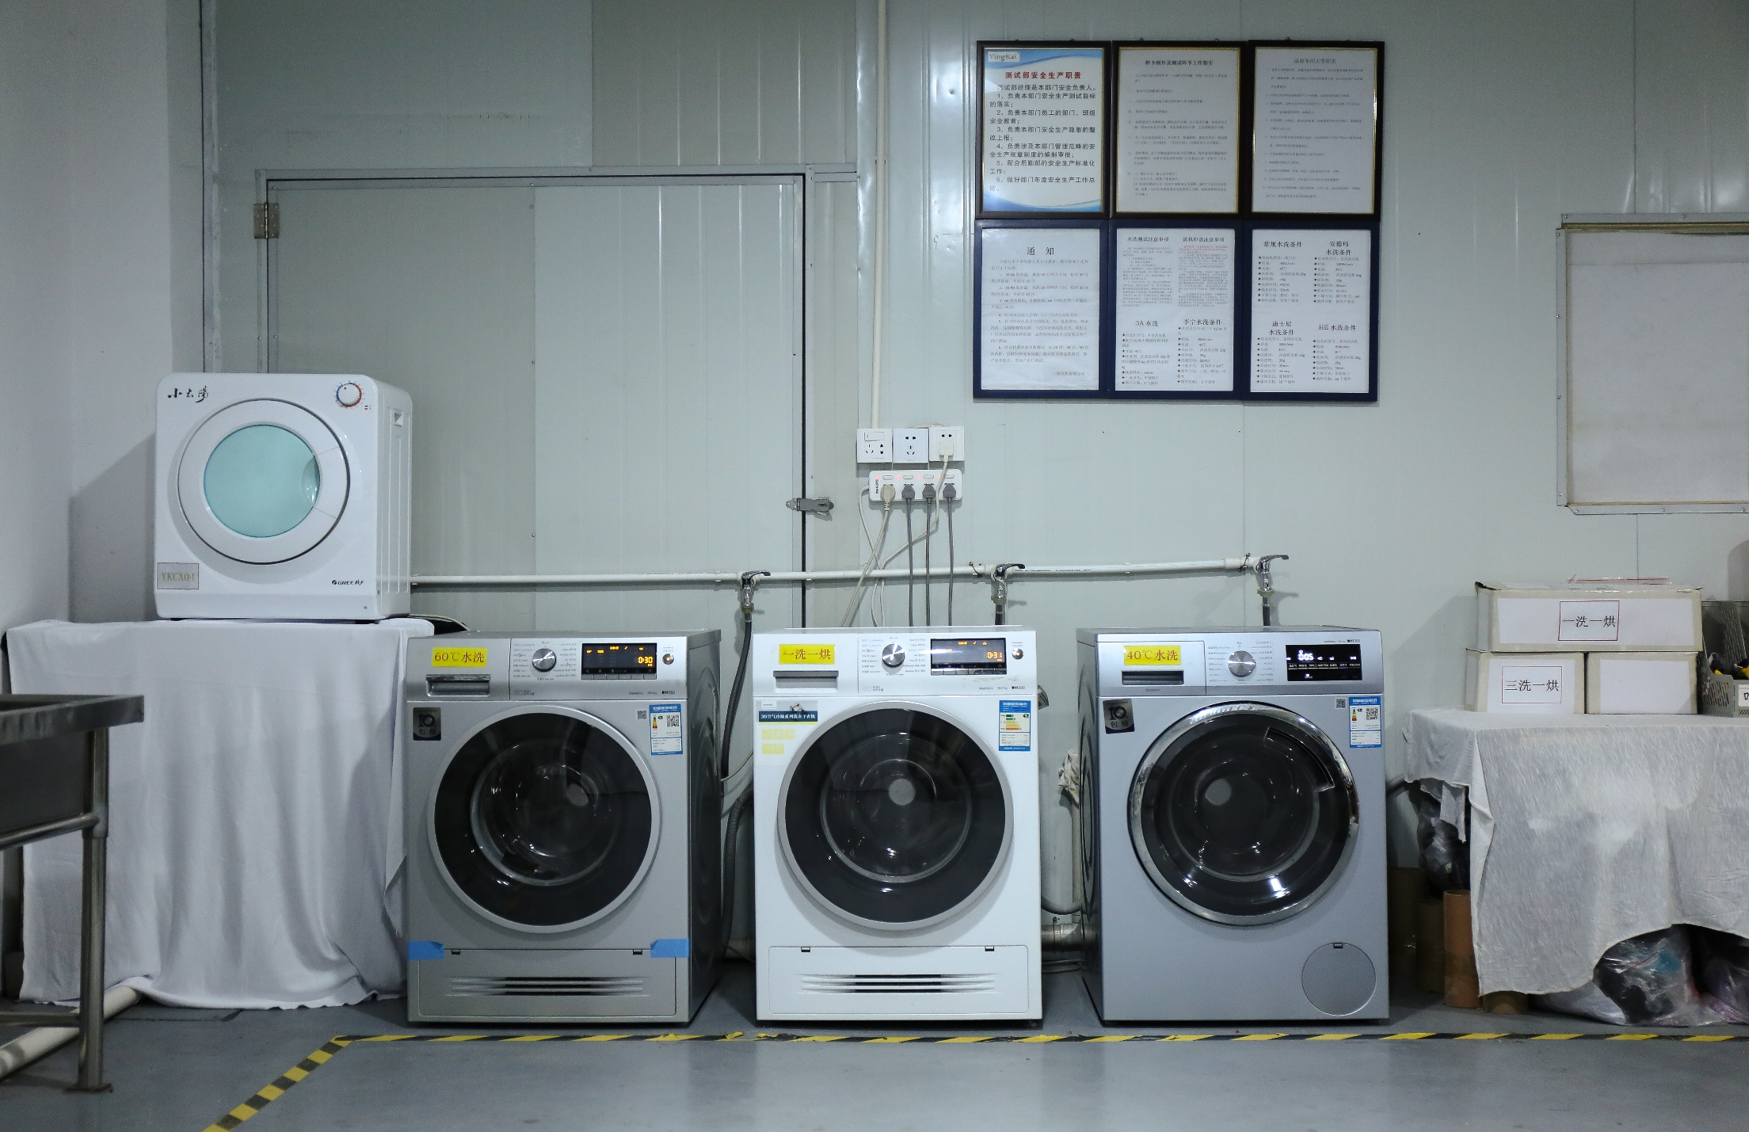
Wuhu factory-In-house Lab
芜湖工厂-工厂实验室

Slide 16
CONTENT
1. Company Introduction
公司介绍
2. Main Products
主要产品
3. Quality Control
品质管控
4. Core Competitive Advantages
核心竞争优势

Slide 17
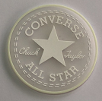
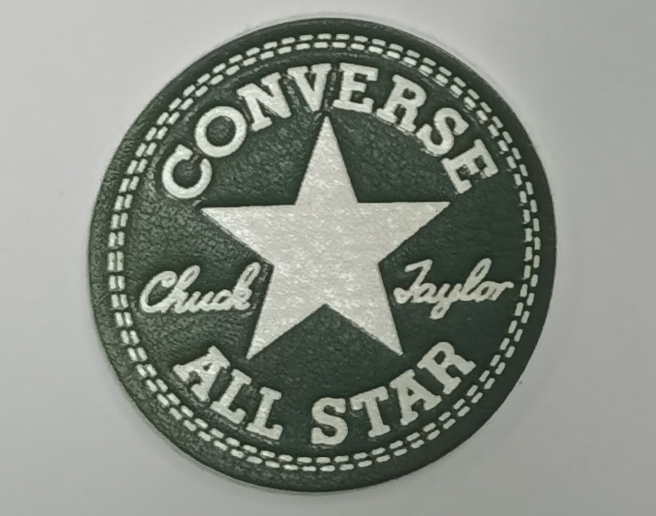
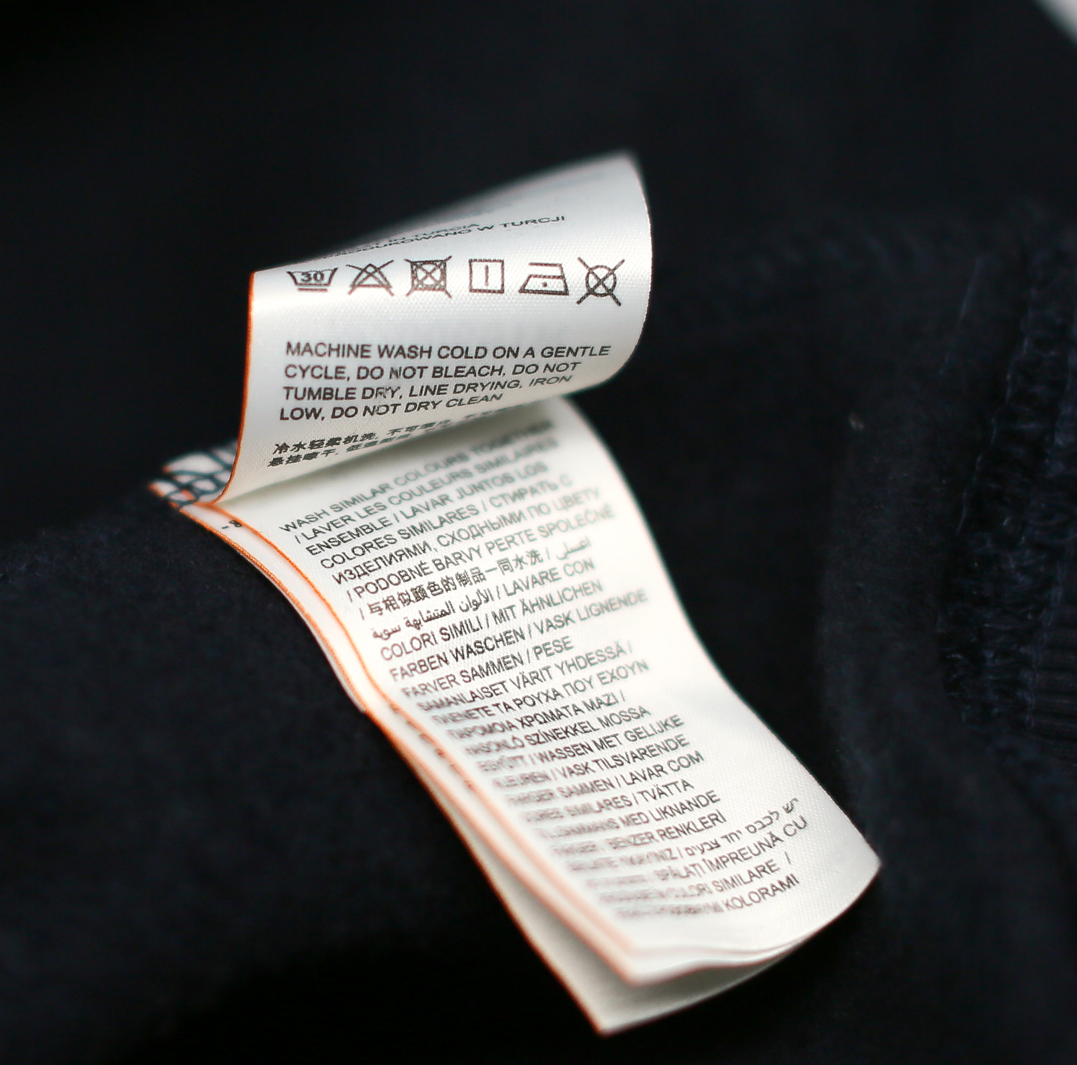
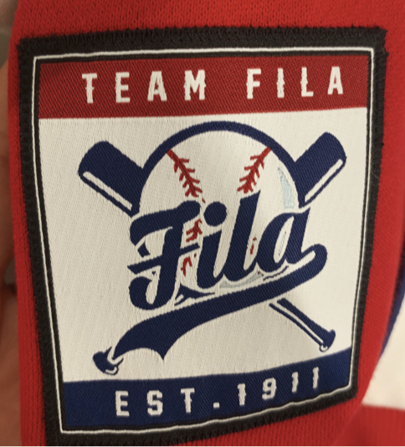
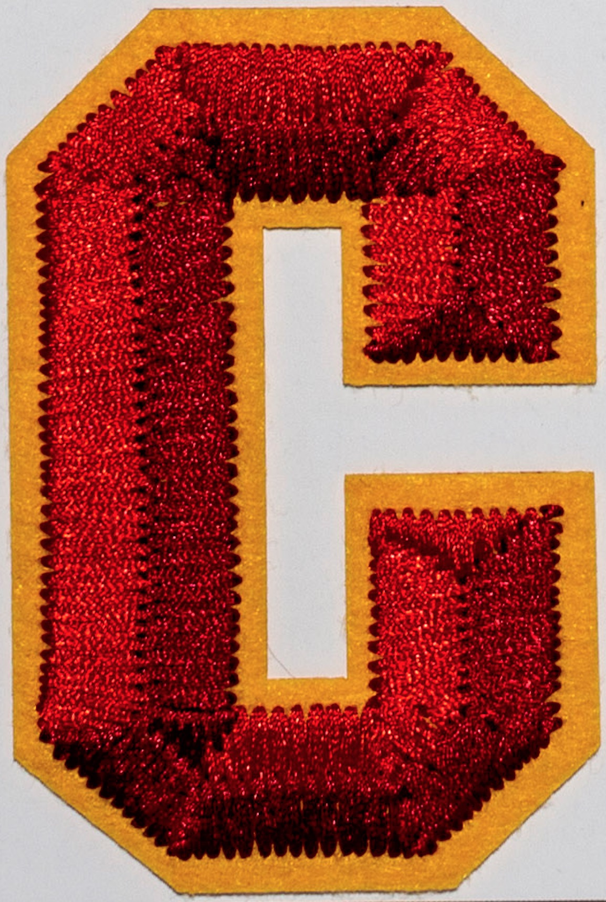
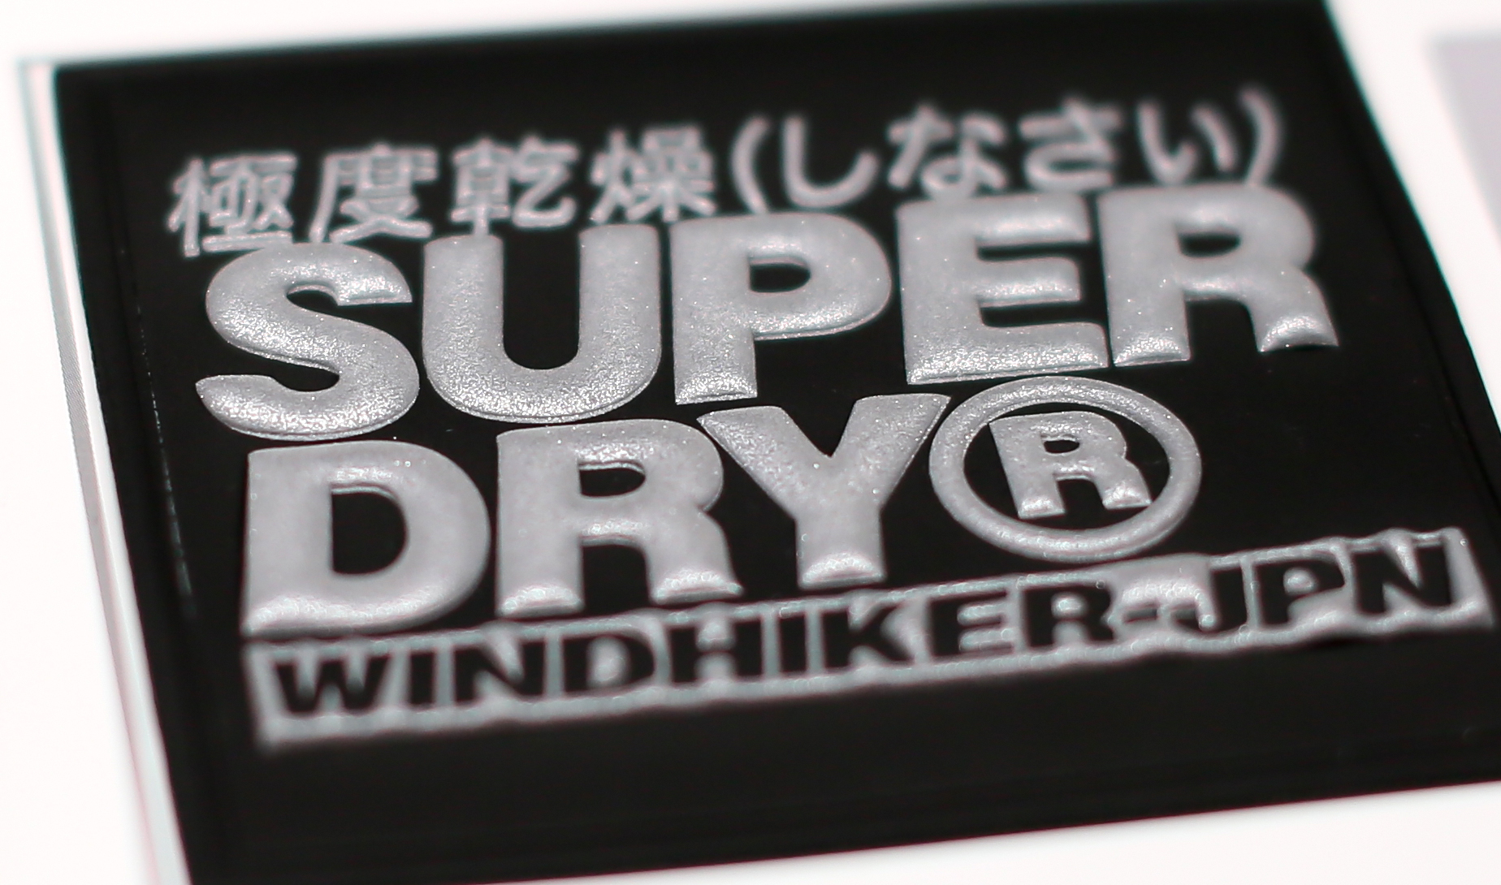
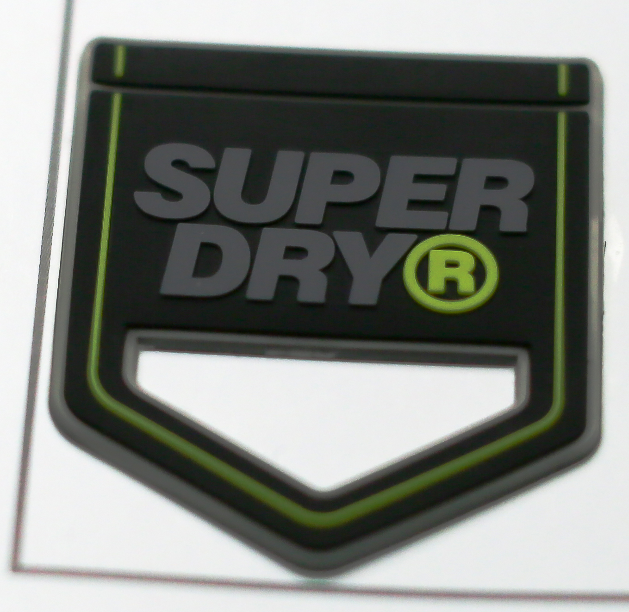
Yingkai Product Family 莹凯产品线
Heat Transfer Label
热转印标
Silicone Heat Transfer Label
硅胶转印标
Silicone Badge
硅胶章
PU patch
PU章
Printed Label
印唛
Woven Label
织唛
Embroidery
绣花章
TPU
TPU 章
PVC
PVC 章

Slide 18
Silicon Badges and Heat Transfer Labels-Yingkai Key Product 硅胶章和热转印标-莹凯主要产品
Solutions Provider to our customers for any kind of base materials and innovative requirements.
为我们的客户提供硅胶章和热转印标解决方案，我们的产品可以印在各种类型的底布上，同时，为我们的
客户提供创新的产品。
Great Innovation and R&D team, to provide our customers Innovative new collections and technologies each season.
拥有强大的创新能力和创新团队，每个季度为我们的客户提供一系列创新的产品和技术。
Provide a rich range innovative products: Stretchable, Reflective, Neon, Light & Heat sensitive, Bright & Matt combination,and Breathable inks etc..
提供丰富多彩的创新产品：弹性、反光、荧光、光照或热感应、亮光和哑光组合，以及透气环保染料

Slide 19
CONTENT
1. Company Introduction
公司介绍
2. Main Products
主要产品
3. Quality Control
品质管控
4. Core Competitive Advantages
核心竞争优势

Slide 20
Quality Control 品质管理
Strictly quality inspection system on each production process, pre-printing, printing, and after printing.
制定了严格的品质管理系统，对每一道工序进行严格品质管控
In-house certified Lab to do the testing & settle the production technologies.
工厂拥有被认证的检验室，对产品进行检测并解决生产中的技术瓶颈
Use the water-based Ink without any PVC or phthalates, keep environment protection and sustainability.
水性油墨，环保及可持续性发展
100% testing once production finished and before shipment.
产品出货前，100%检验检测，确保好的品质产品

Slide 21
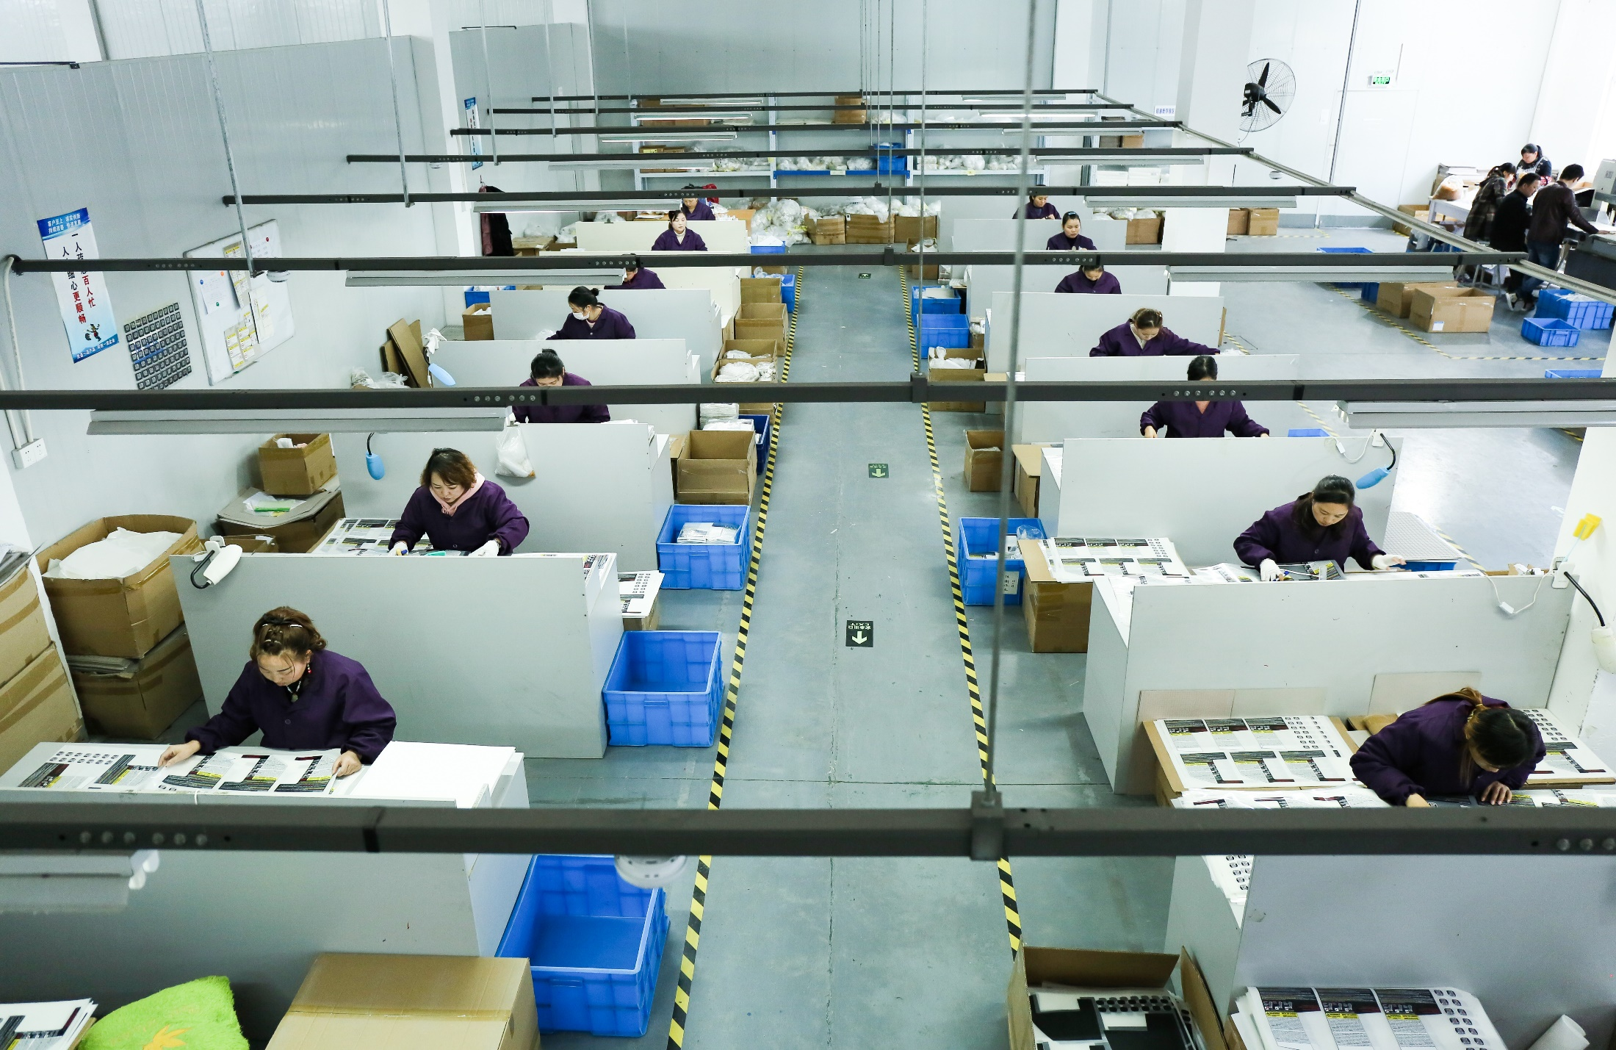
Quality Control 品质管理

Slide 22
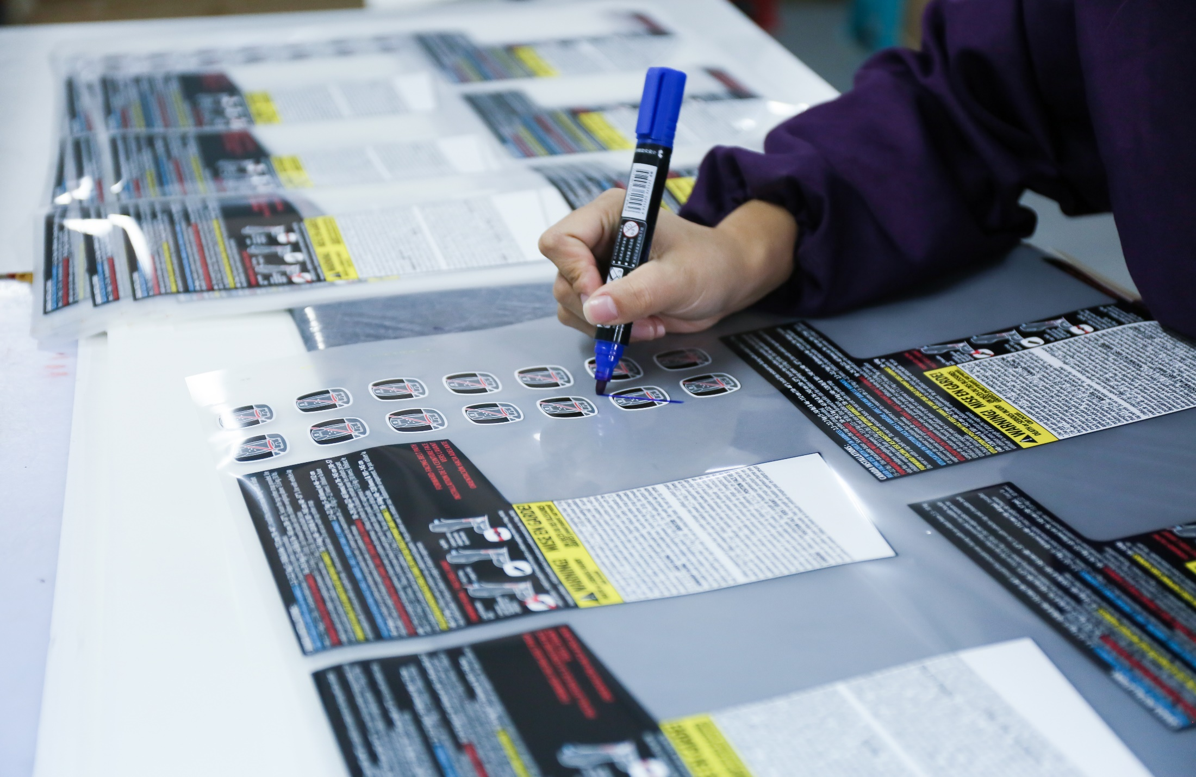
Quality Control 品质管理

Slide 23
Sustainability 可持续发展
Got the BSCI and Oeko-Tex 100 certificate
获得了BSCI 和Oeko-Tex 100证书
Use the water-based Ink without any PVC or phthalates, keep environment protection and sustainability.
基于水的染料，环保及可持续性发展
Apply the environmental materials, all production waste is treated properly. All products must pass the safety and environment tests before shipping to our customers.
应用环保材料，所有生产的材料都会被恰当地处理，满足环保标准和要求，所有产品都经过严格的安全和环保检测。
Provide and use these sustainable materials:应用以下环保材料：
Water-based Inks 基于水的染料
Organic Cotton 再生棉
Recycled polyester再生涤纶
FSC Paper PSC纸张

Slide 24
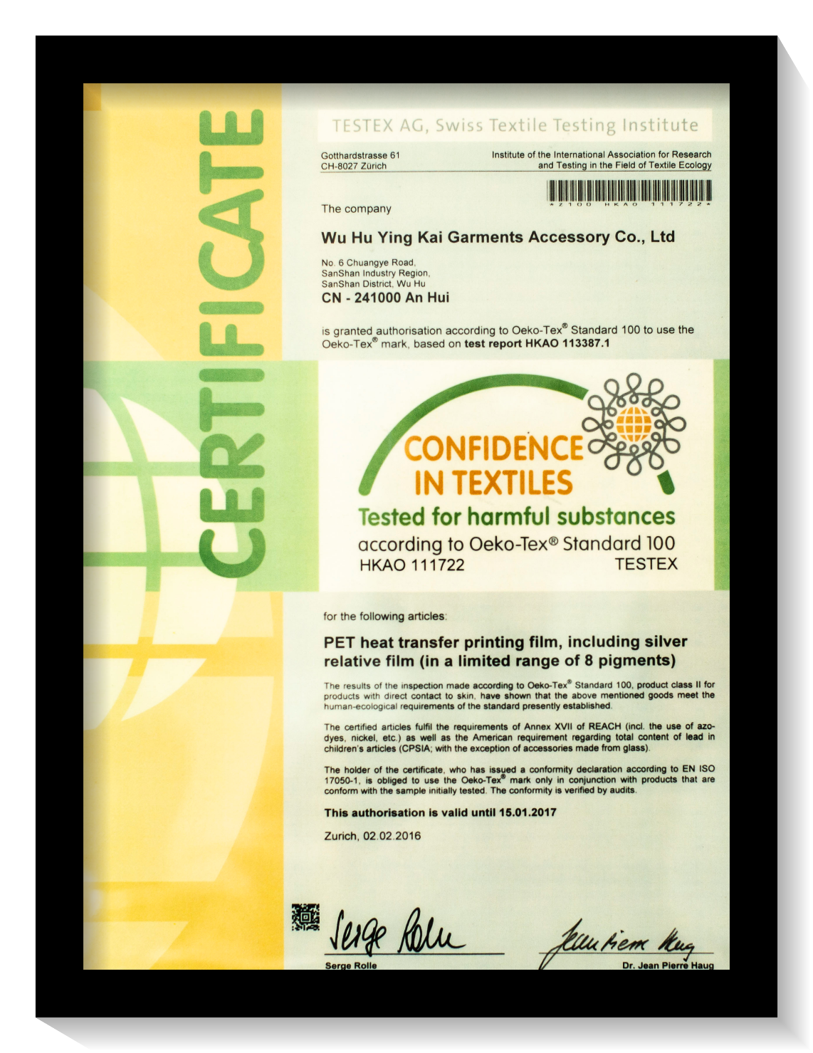
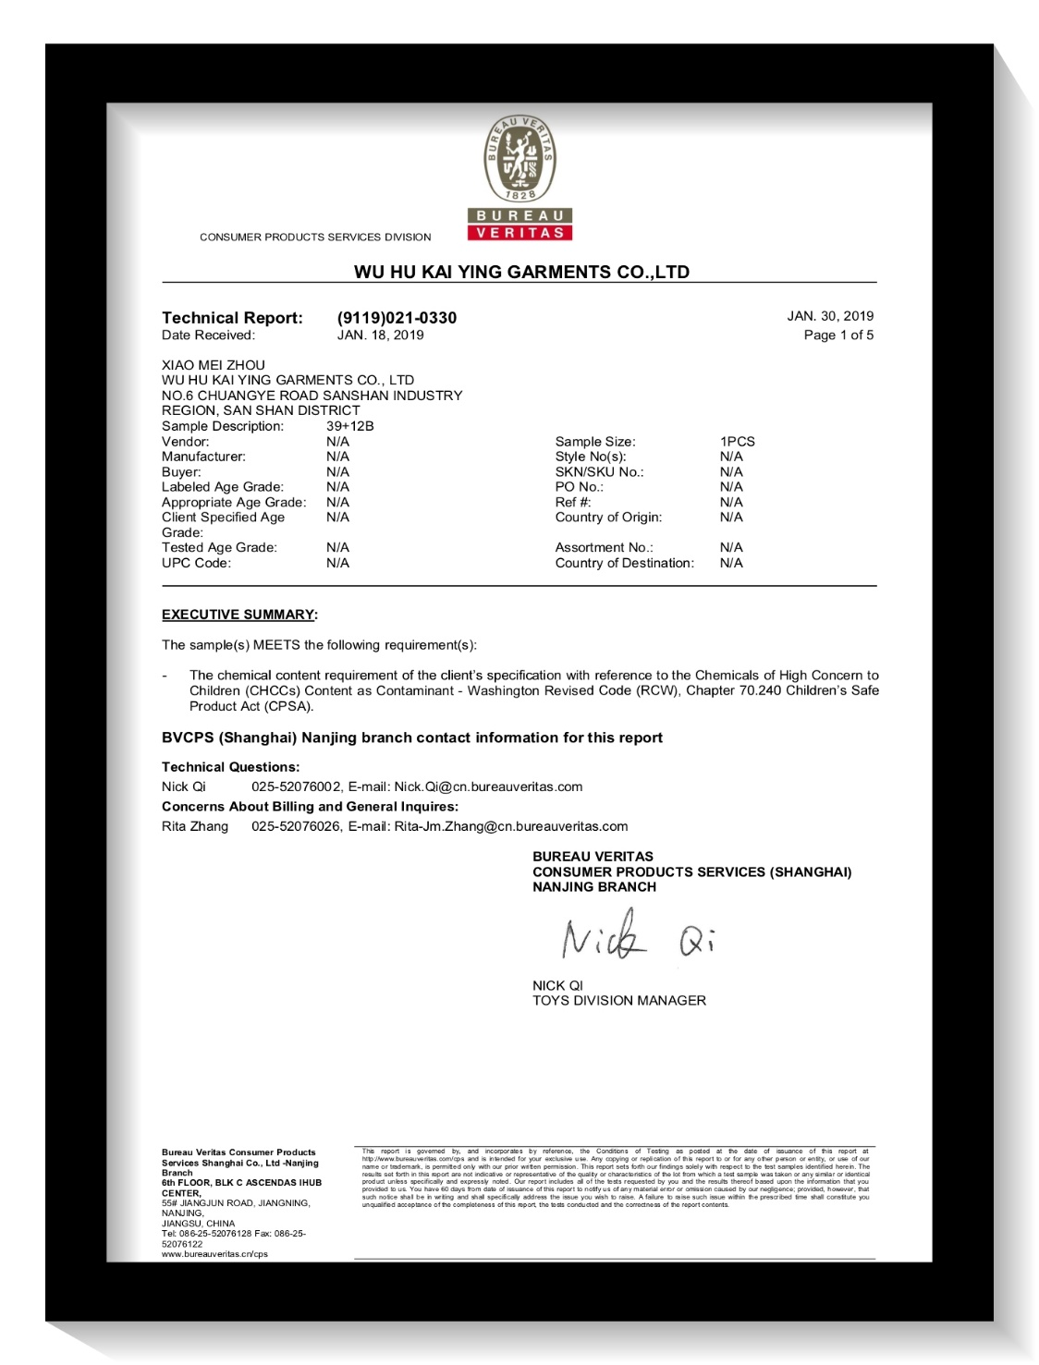
Quality Control品质管理

Slide 25
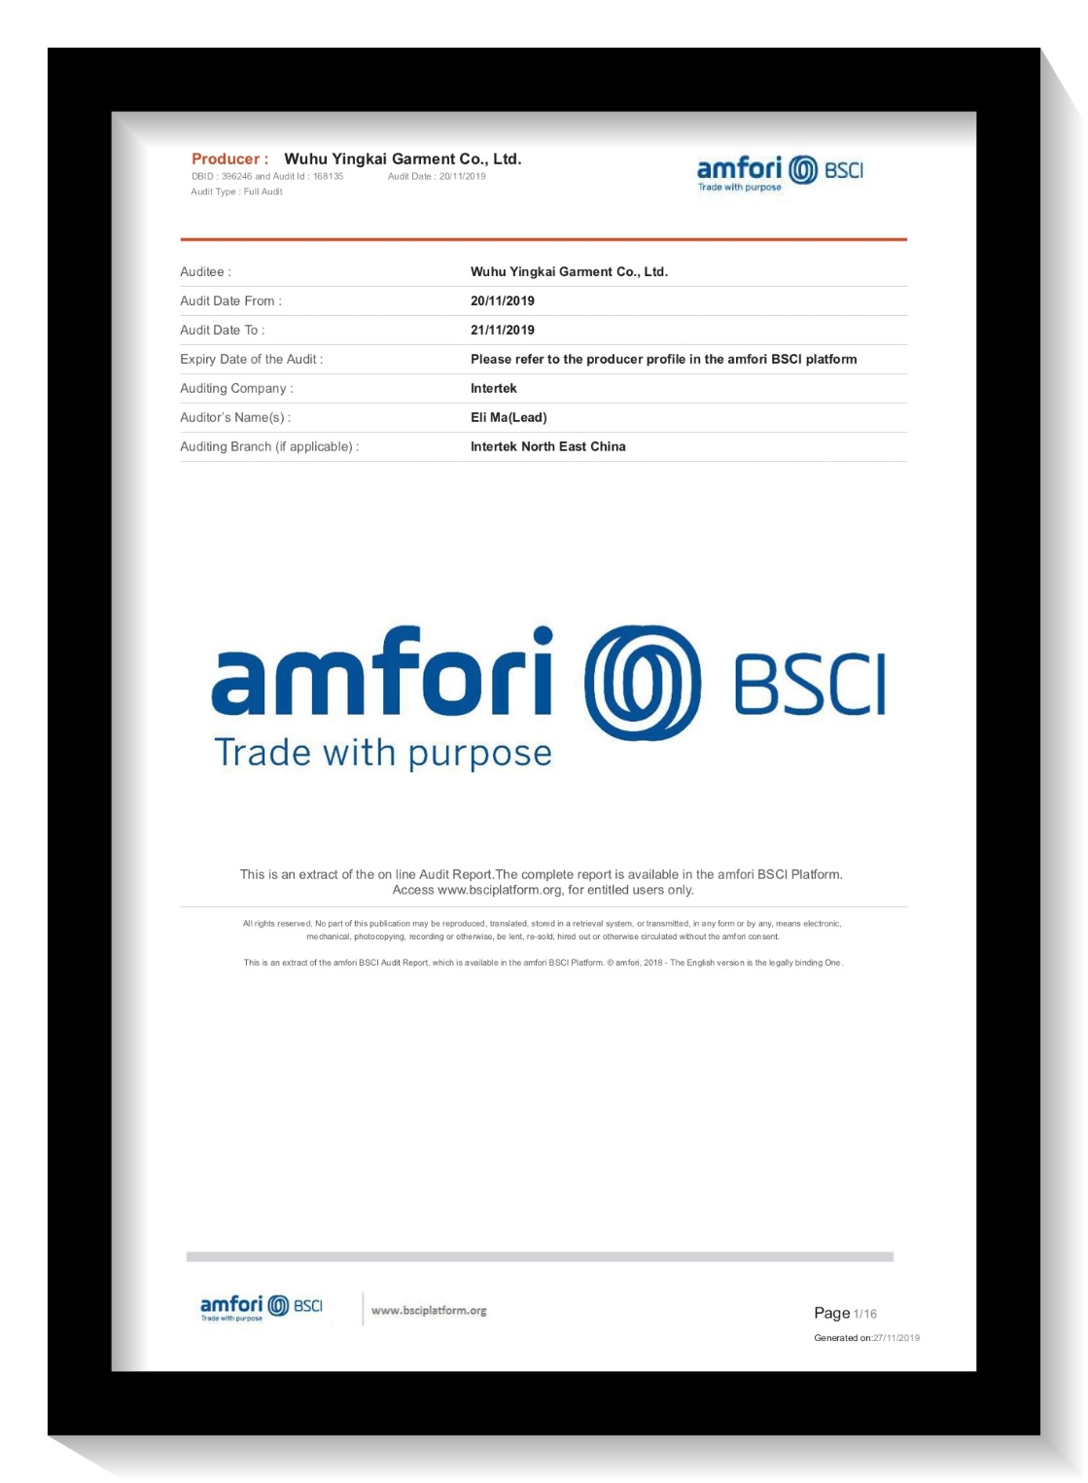
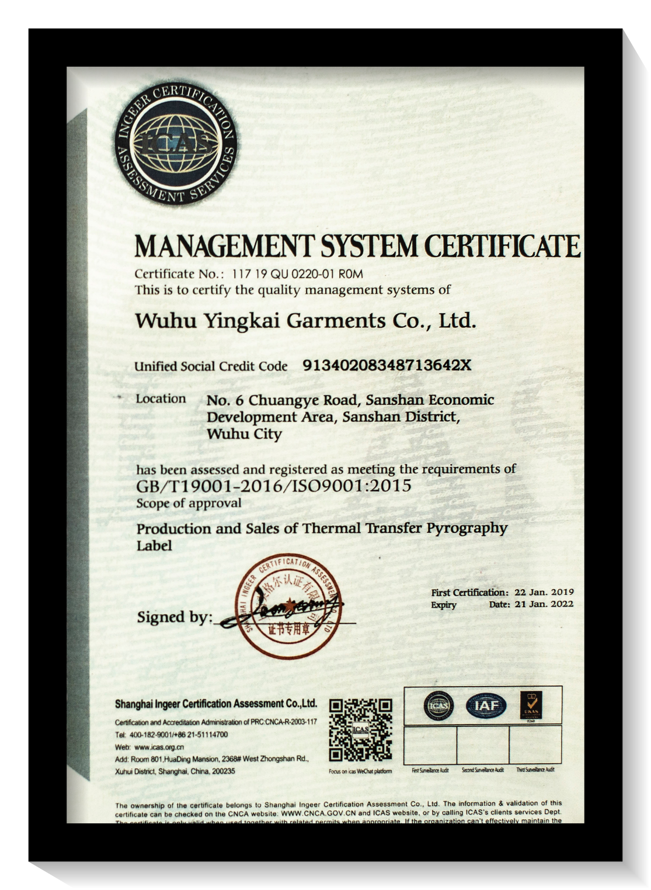
Sustainability 可持续发展

Slide 26
CONTENT
1. Company Introduction
公司介绍
2. Main Products
主要产品
3. Quality Control
品质管控
4. Core Competitive Advantages
核心竞争优势

Slide 27
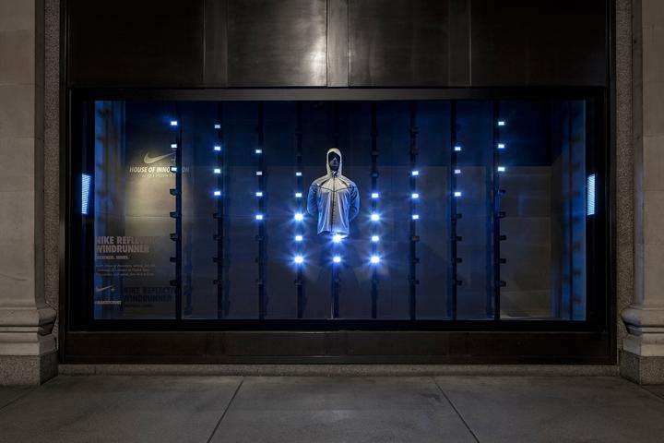
Core Competitive Advantages 核心竞争优势
Great Innovation
强大创新能力
Competitive Price
竞争优势价格
Professional Team
专业化团队

Slide 28
Great Innovation
强大的创新能力
Customers-oriented, focus on customers’ needs, bring the most creative collections and concepts for customers.
客户导向，专注于客户需求，给客户提供最具创新的系列产品和概念
Strong Innovation Team: over 30 team members R&D and Innovation team, focusing on the raw materials development and the design creation.
强大的创新团队，超过30人的创新研发团队，专注于原材料的研发和设计的创造
Innovation
01
02
Great
Capability
Yingkai
Yingkai is recognized by customers as the very innovative supplier
莹凯被许多客户认可为非常创新的辅料供应商
Long-term strategy for the innovation, Innovative culture and DNA.
创新成为莹凯长远战略，已经成为莹凯的文化及DNA
04
03

Slide 29
Competitive Price
竞争优势的价格
Competitive Price
竞争优势的价格
Competitive Price
竞争优势的价格
Fully automatic and Semi-automatic production line , all made in house, totally cost control.
全自动及半自动化生产线，所有生产均在自己工厂完成，并且达成了很好的成品管控
Big scale production, high productivity and efficiency.
达成了大规模化生产，高的生产效率和生产力
Price
01
02
Competitive
Capability
Keep optimizing the production system to continuous improve the productivity and efficiency.
持续改进优化生产管理系统，不断提高生产效率和生产力
Yingkai
Long-term strategy to maintain the competitive price
保持竞争优势价格，成为莹凯的发展战略
04
03

Slide 30
Protect The House
保护我们的家园
Thank you!

