Slide 1
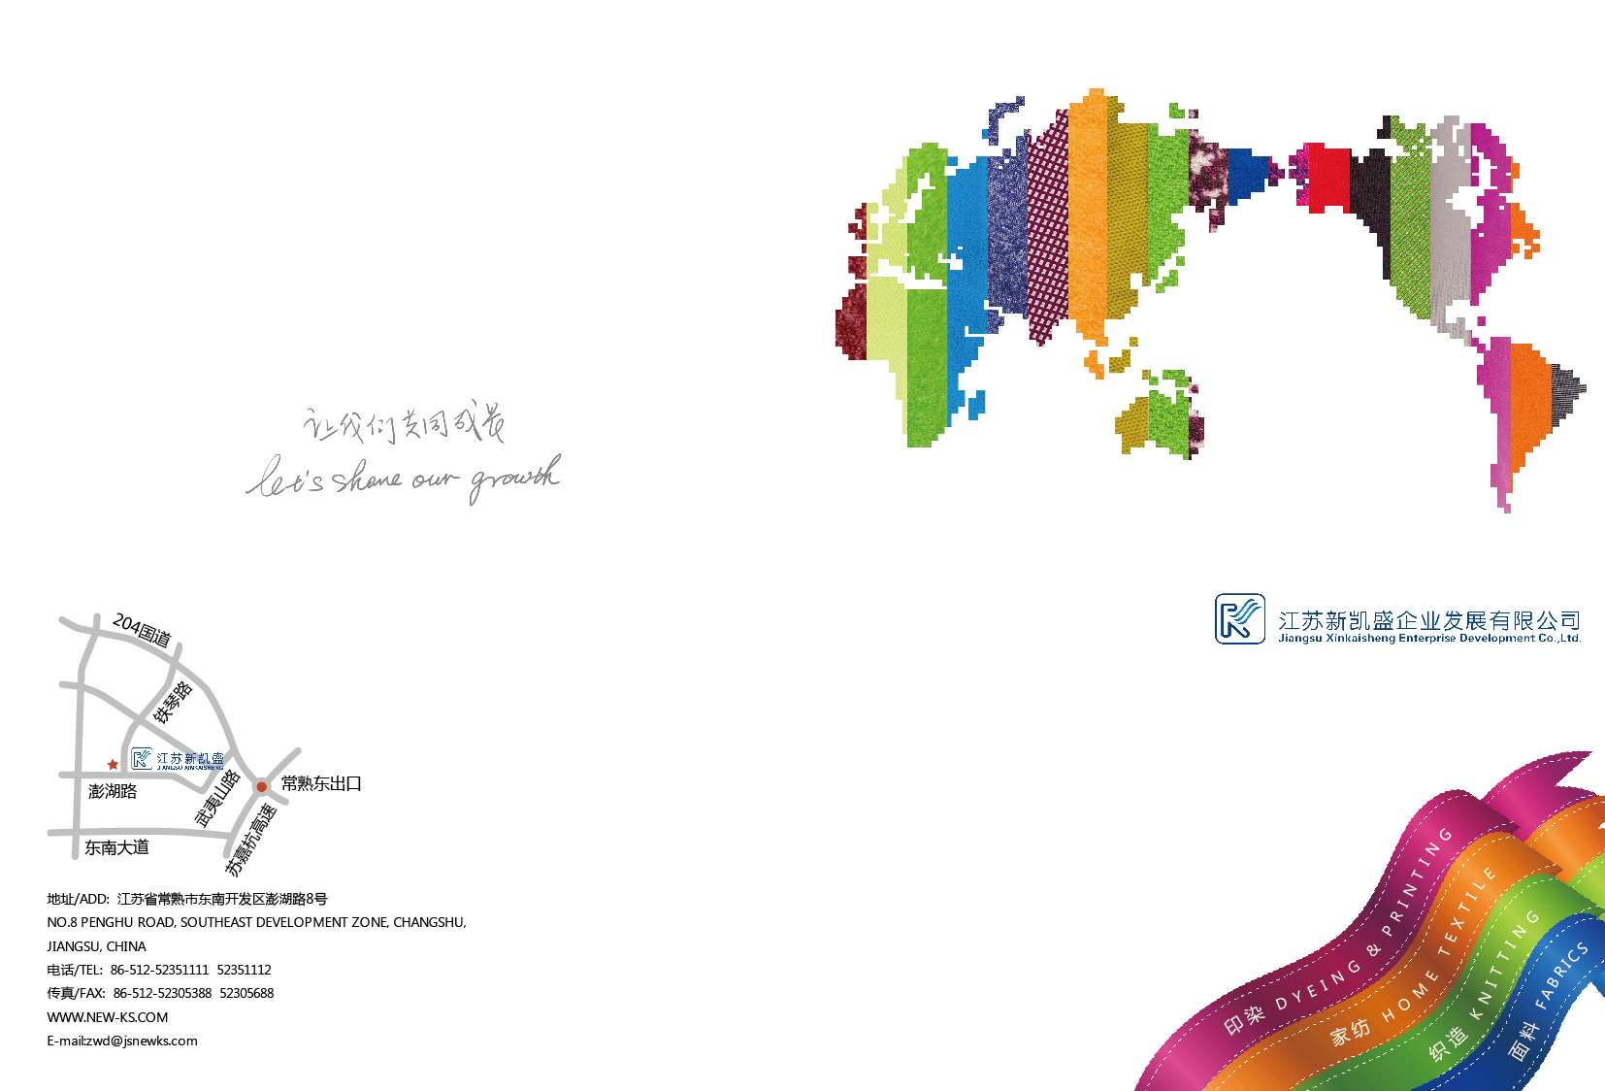

江 苏 新 凯 盛 企 业 发 展 有 限 公 司
Jiangsu Xinkaisheng Enterprise Development Co.,Ltd

Slide 2
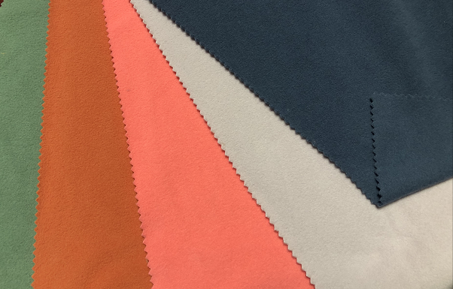
主要产品介绍：
MAINLY PRODUCT INTRODUCTION:
1.摇粒绒MICRO FLEECE: 20T/DAY
柔软/舒适/暖感 SOFT/COMFORTABLE/WARM

Slide 3
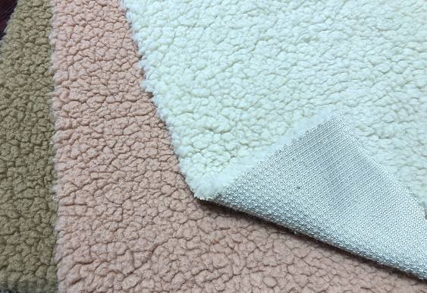
2.舒棉绒 BOA FLEECE: 25T/DAY
美观/时尚/保暖 GOOD LOOK/FASHION/WARM

Slide 4
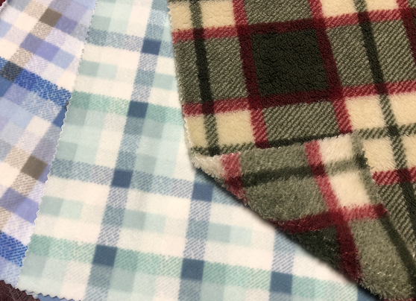
3.印花 PRINT FLEECE 30T/DAY
无局限性/多元素组合/时尚
NO LIMITATION/MULTI ELEMENT COMBINATION/FASHION

Slide 5
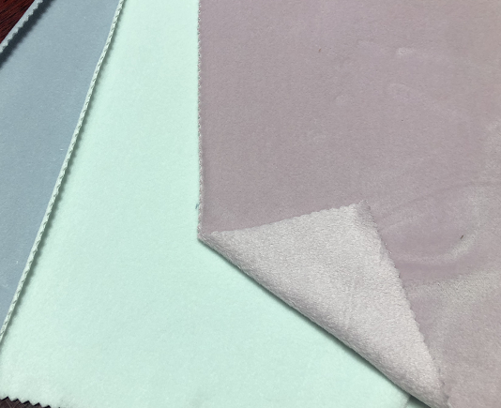
4.宝宝绒 BABY FLEECE 12T/DAY
柔软/舒适/高弹 SOFT/COMFORTABLE/ULTRA STRECH

Slide 6
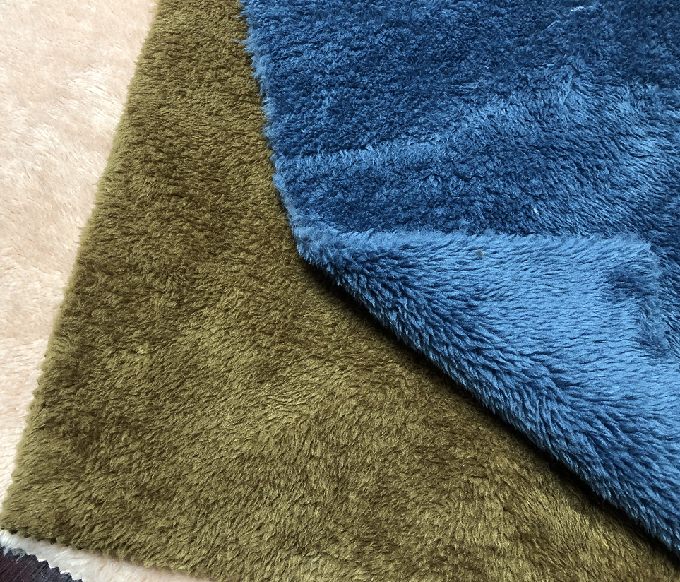
5.贴合布 BONDED FLEECE 35T/DAY
保暖/柔软/功能性（防风防水）
WARM/SOFT/FUCTIONAL(WINDPROOF/WATERPROOF)

Slide 7
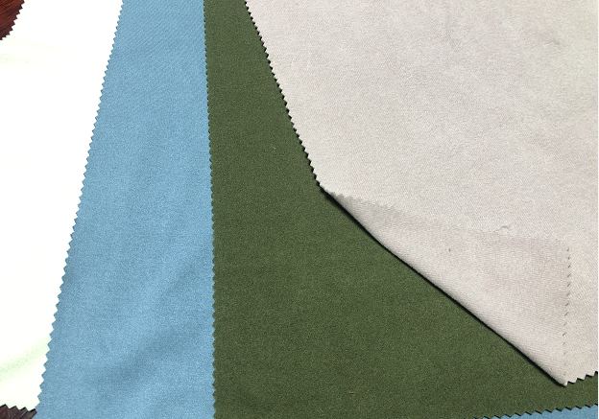
新品推荐 NEW PRODUCT RECOMMENDATION
1.棉毛布 SOFT FLEECE 12T/DAY
运用新工艺造就高手感/高弹效果/亲肤感
USE NEW TECHNOLOGY TO MAKE GOOD HANDFEEL / ULTRA STRECH/SKIN FEELING

Slide 8
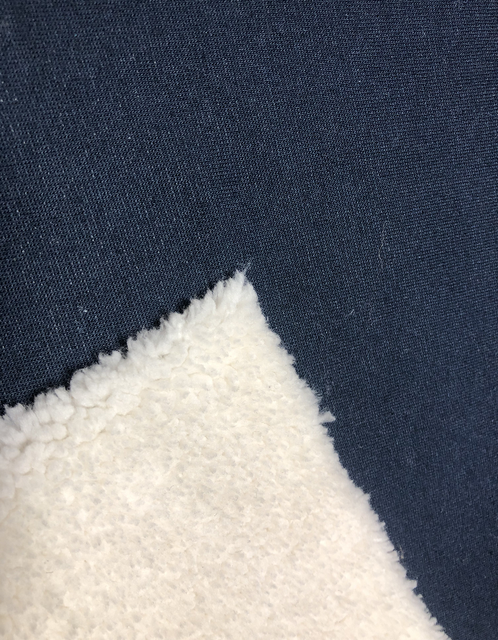
2.一体BOA 3.5T/DAY
运用新织造工艺造就高效/环保/无厚重感的面料
USE NEW KNITTING TECHNOLOGY TO MAKE EFFICIENTLY/ENVIRONMENT PROTECTION/NO SENSE OF MASSINESS

Slide 9
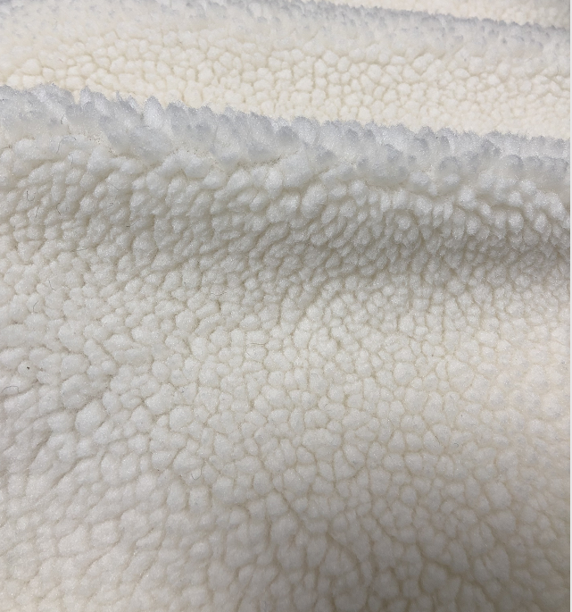
3. 泡泡绒（BUBBLE FLEECE）8T/DAY
纱线的变化使面料表面颗粒更加立体，有大毛皮的感觉
The change of yarn makes the surface grain more three-dimensional, with the feeling of high pile

Slide 10
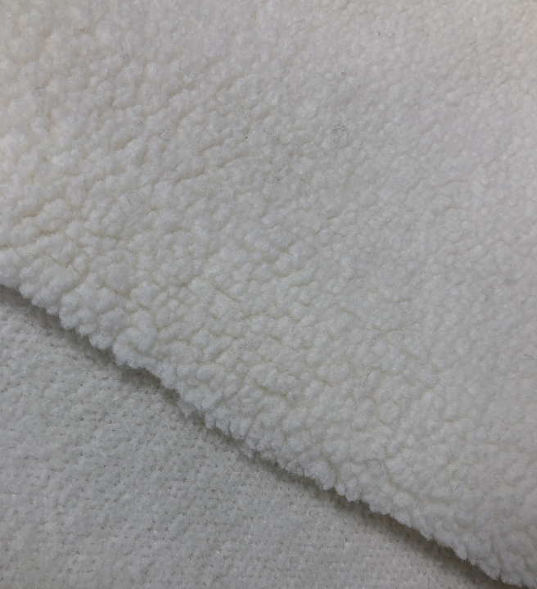
4.一面泡泡绒一面摇粒绒 ONE SIDE BUBBLE ONE SIDE MICRO FLEECE
代替贴合的面料，在物性不变的情况下使面料更轻，性价比更高
Replace the bonded fabric, make the fabric lighter and more cost-effective without changing the physical properties

Slide 11
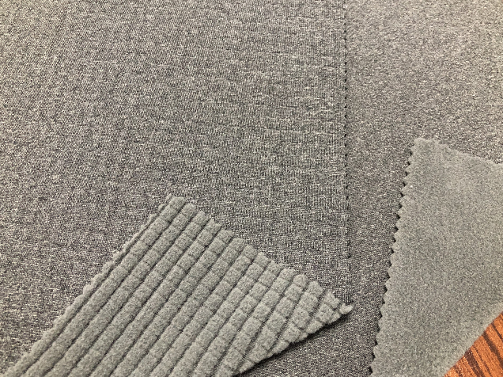
5.高弹摇粒绒/格子绒 MICRO FLEECE WITH ULTRA STRECH
改变织造的工艺使面料可以变化的同时具有高弹的功能
Changing the knitting way can make the fabric surface change and have the function of high elasticity

Slide 12
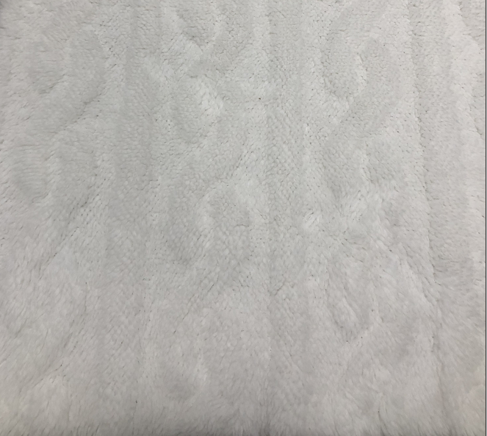
6.提花舒棉绒 JACQUARD BOA
改变织造工艺，使面料实现表面花型的任意更改
Change knitting machine to make the fabric surface pattern can be changed at will

